Slide 1


Slide 2




MYSQL
POWERBI
PYTHON
EXCEL
This involved working with Excel dashboards, utilizing pivot tables for data analysis and visualization. The data was structured efficiently by renaming tables and modifying data types to ensure consistency and accuracy. These enhancements provided better insights into e-commerce delivery trends, enabling improved decision-making based on key metrics such as order volume, revenue, delivery times, and customer feedback.
Exploratory Data Analysis (EDA) techniques, including understanding the dataset structure, cleaning inconsistencies, handling missing values, and performing data visualization using Python. Various plots were used to analyze delivery performance, customer satisfaction, and platform comparisons, providing insights to optimize e-commerce delivery operations.
MySQL methods, such as creating triggers to automate data handling, inserting deleted records into platform-specific tables, and filtering data based on platform types, were utilized to ensure efficient database management and maintain data integrity in e-commerce delivery operations. Additionally, Power BI was connected to MySQL to load and visualize data from the database, enabling comprehensive analysis and reporting of e-commerce delivery trends.
Power BI was connected to MySQL, enabling efficient data loading and visualization of e-commerce delivery operations. It was leveraged to analyze key metrics such as total orders, revenue, average delivery time, and service ratings across different platforms and product categories. Through interactive dashboards, insights were derived on delivery delays, customer feedback trends, and refund patterns, facilitating data-driven decision-making to optimize e-commerce logistics.
E-COMMERCE DELIVERY
ANALYSIS

Slide 3
PYTHON
EXCEL
MYSQL
POWERBI
Exploratory Data Analysis (EDA) techniques, including understanding the dataset structure, cleaning inconsistencies, handling missing values, and performing data visualization using Python. Various plots were used to analyze delivery performance, customer satisfaction, and platform comparisons, providing insights to optimize e-commerce delivery operations.
This involved working with Excel dashboards, utilizing pivot tables for data analysis and visualization. The data was structured efficiently by renaming tables and modifying data types to ensure consistency and accuracy. These enhancements provided better insights into e-commerce delivery trends, enabling improved decision-making based on key metrics such as order volume, revenue, delivery times, and customer feedback.
MySQL methods, such as creating triggers to automate data handling, inserting deleted records into platform-specific tables, and filtering data based on platform types, were utilized to ensure efficient database management and maintain data integrity in e-commerce delivery operations. Additionally, Power BI was connected to MySQL to load and visualize data from the database, enabling comprehensive analysis and reporting of e-commerce delivery trends.
Power BI was connected to MySQL, enabling efficient data loading and visualization of e-commerce delivery operations. It was leveraged to analyze key metrics such as total orders, revenue, average delivery time, and service ratings across different platforms and product categories. Through interactive dashboards, insights were derived on delivery delays, customer feedback trends, and refund patterns, facilitating data-driven decision-making to optimize e-commerce logistics.
E-COMMERCE DELIVERY
ANALYSIS

Slide 4

PYTHON
Exploratory Data Analysis (EDA)

Slide 5
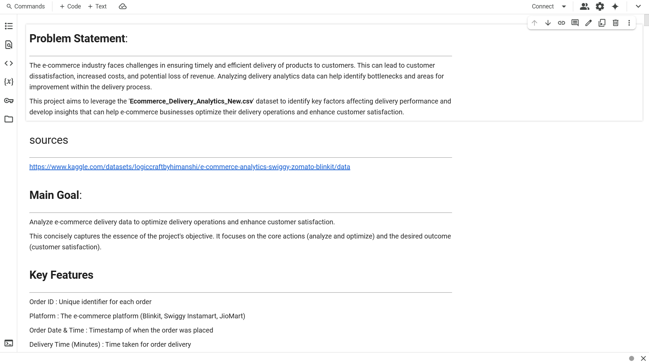

Slide 6
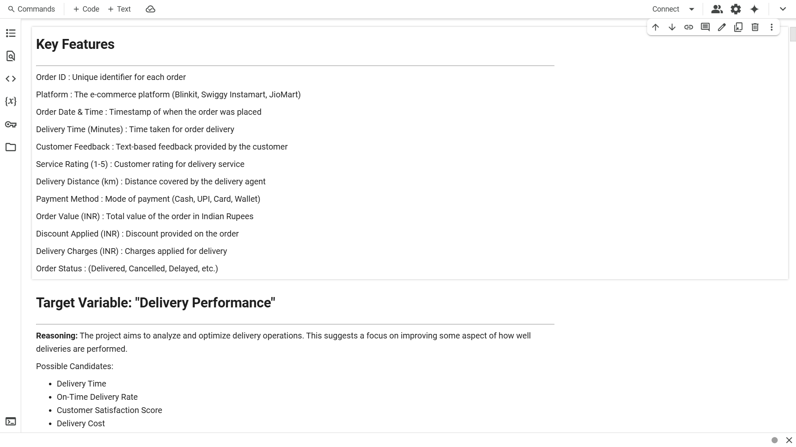

Slide 7
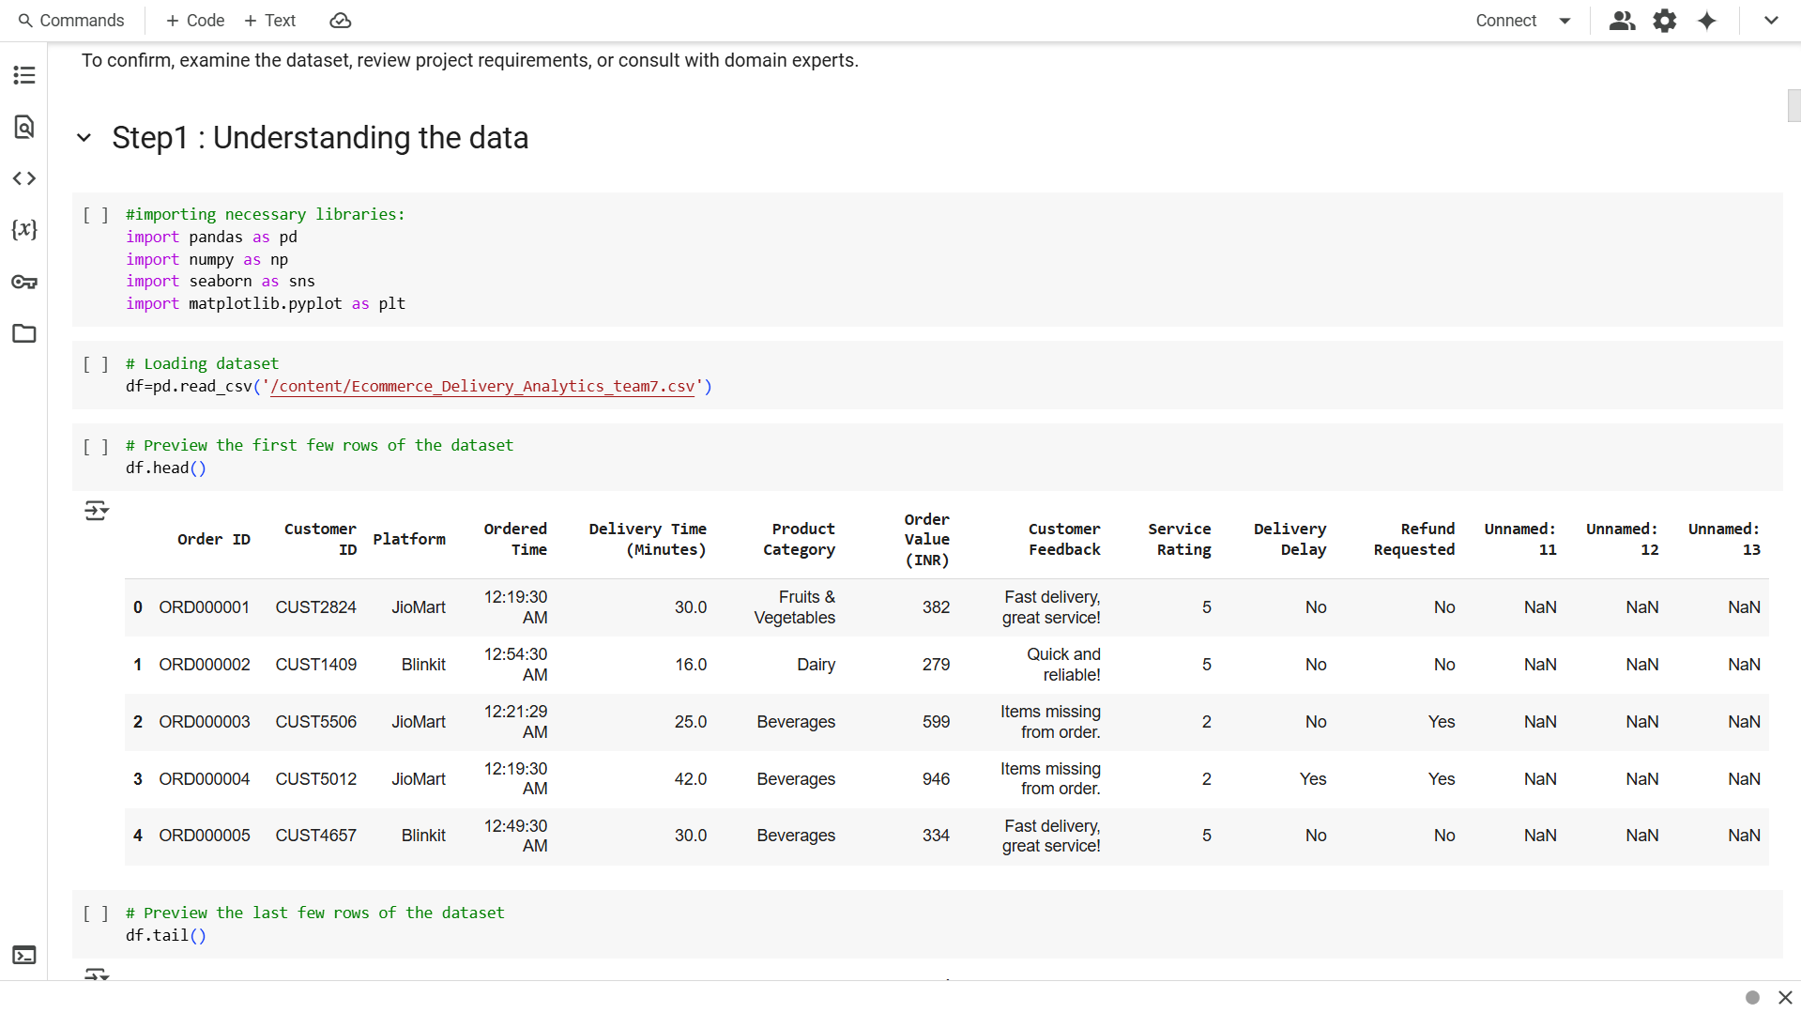

Slide 8
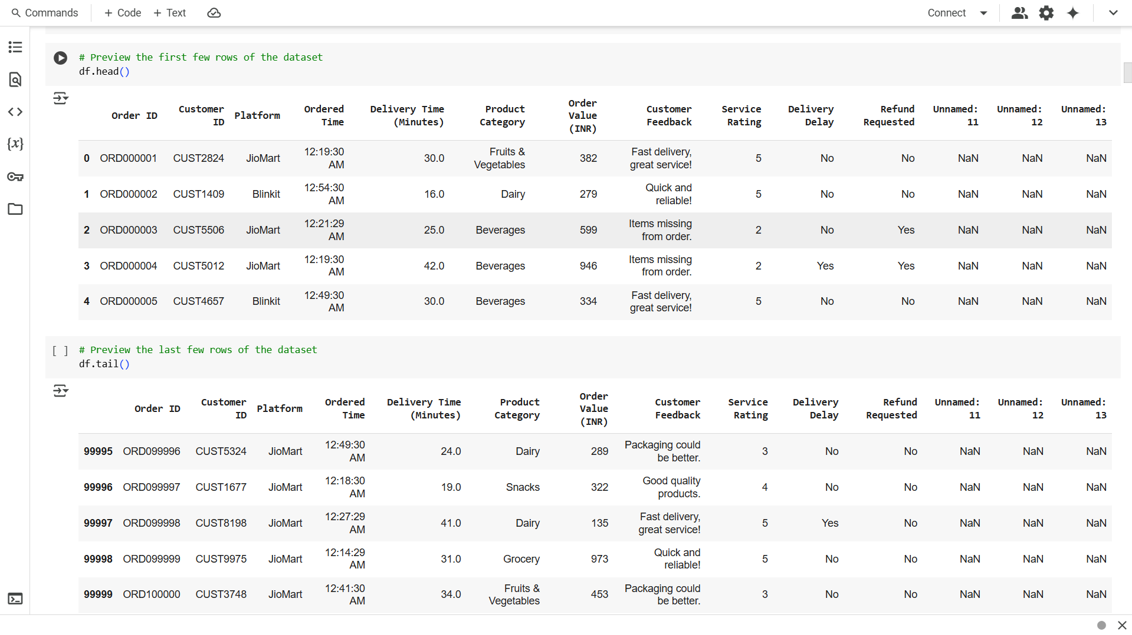

Slide 9
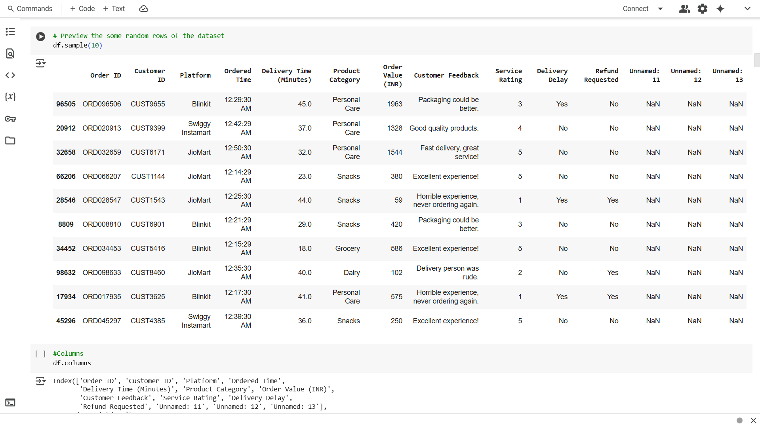

Slide 10
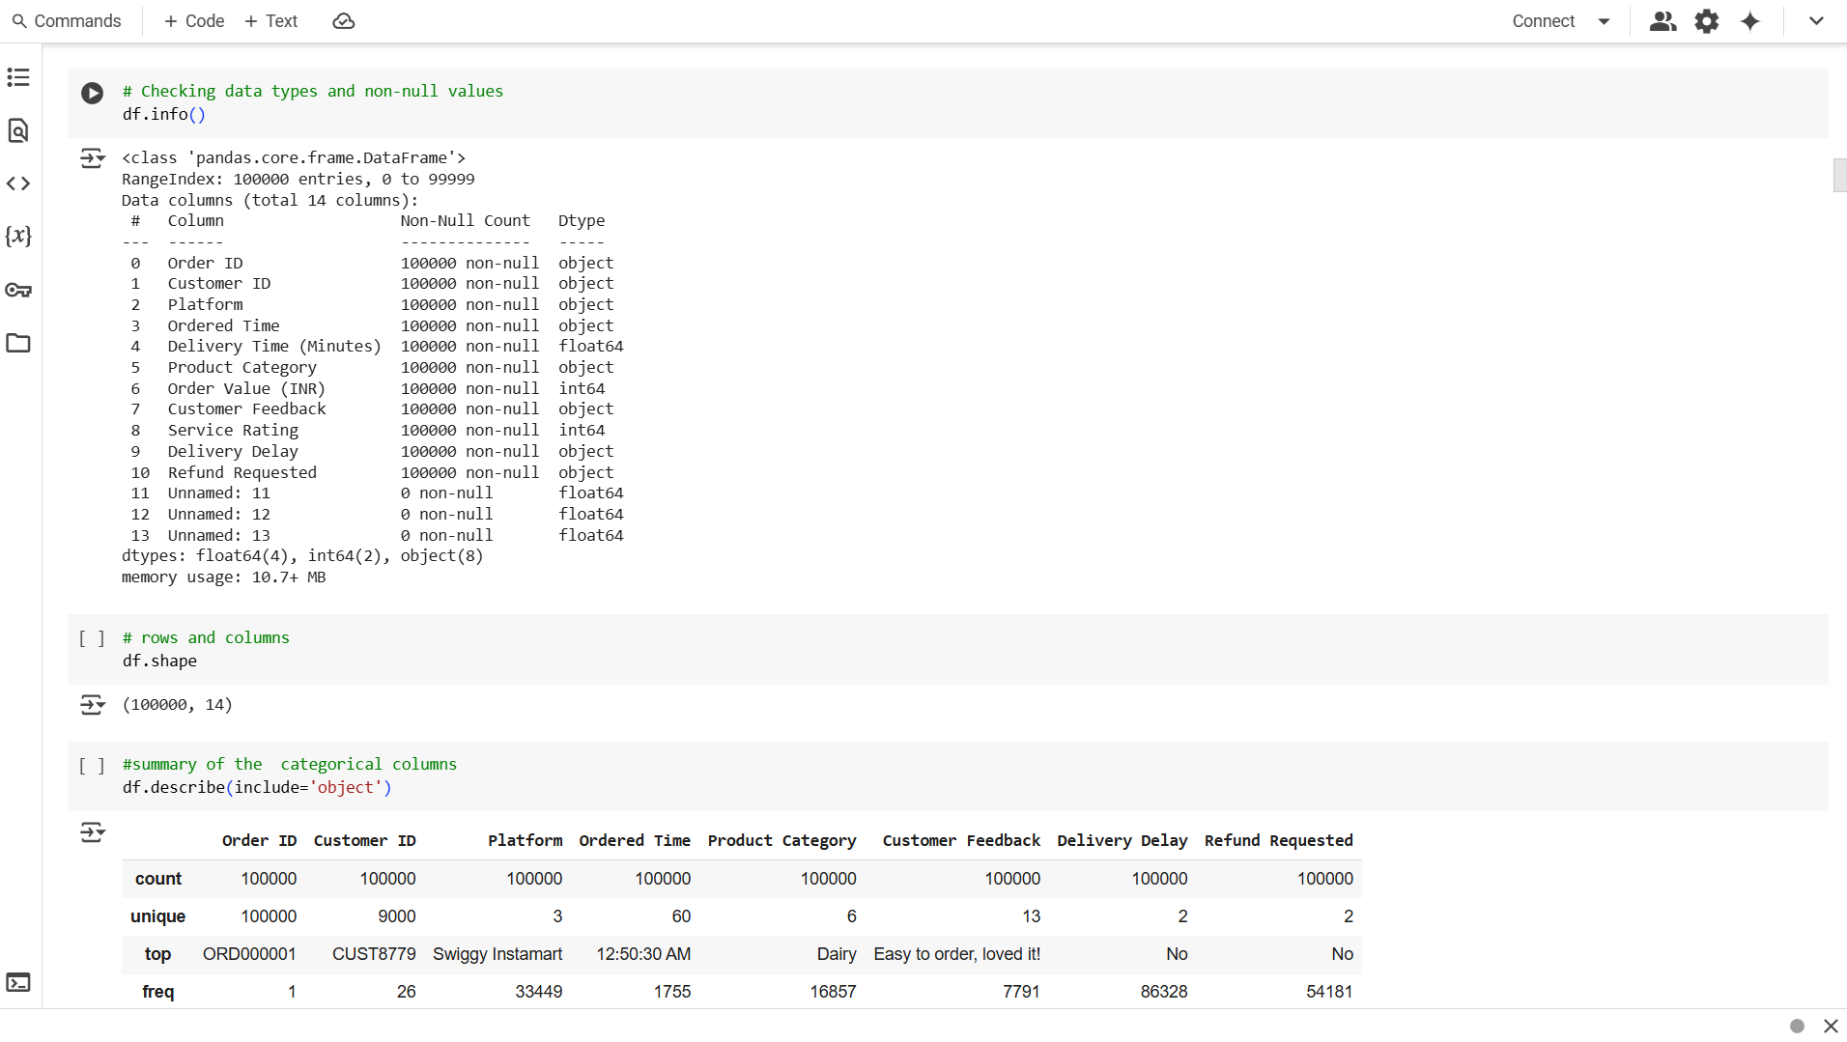

Slide 11
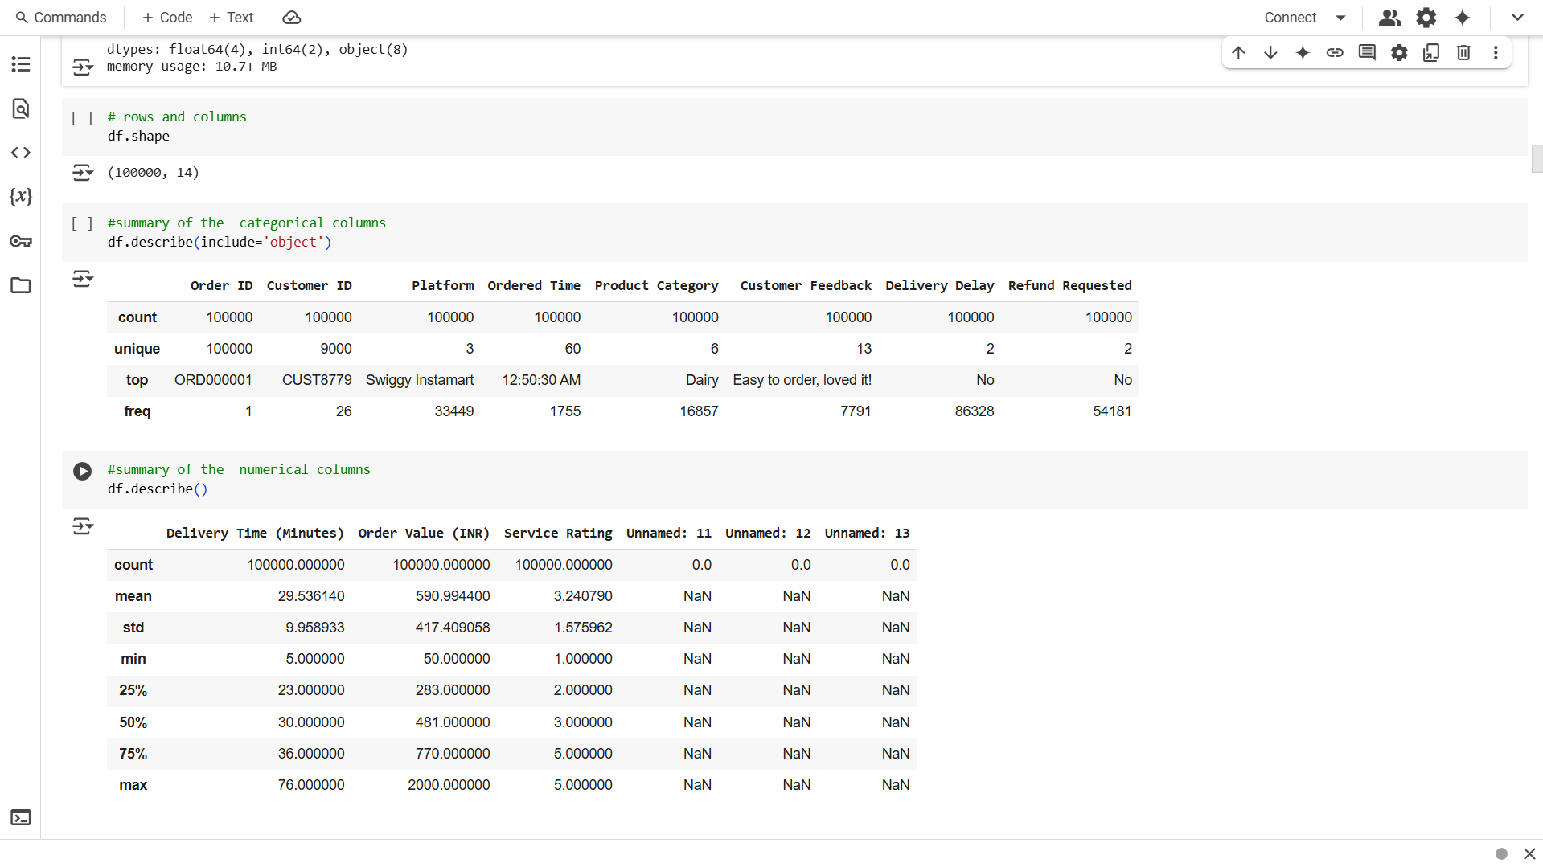

Slide 12
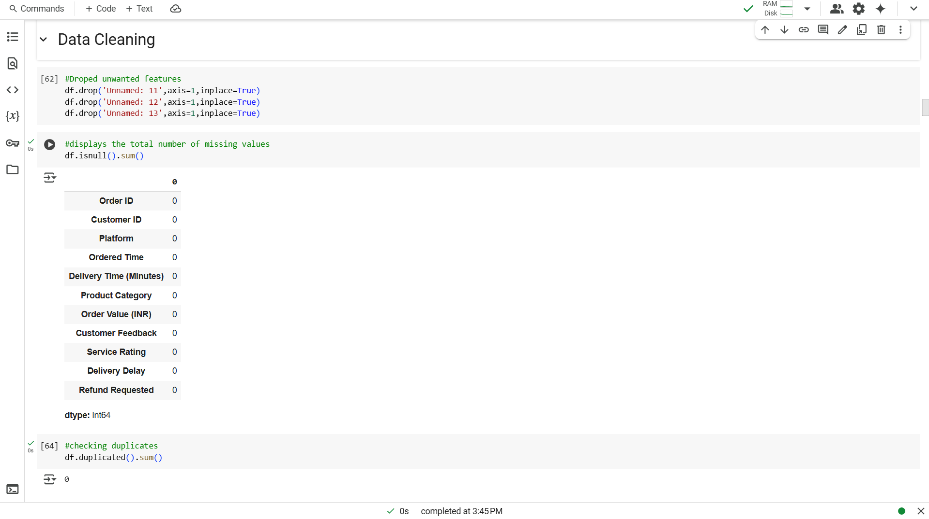

Slide 13
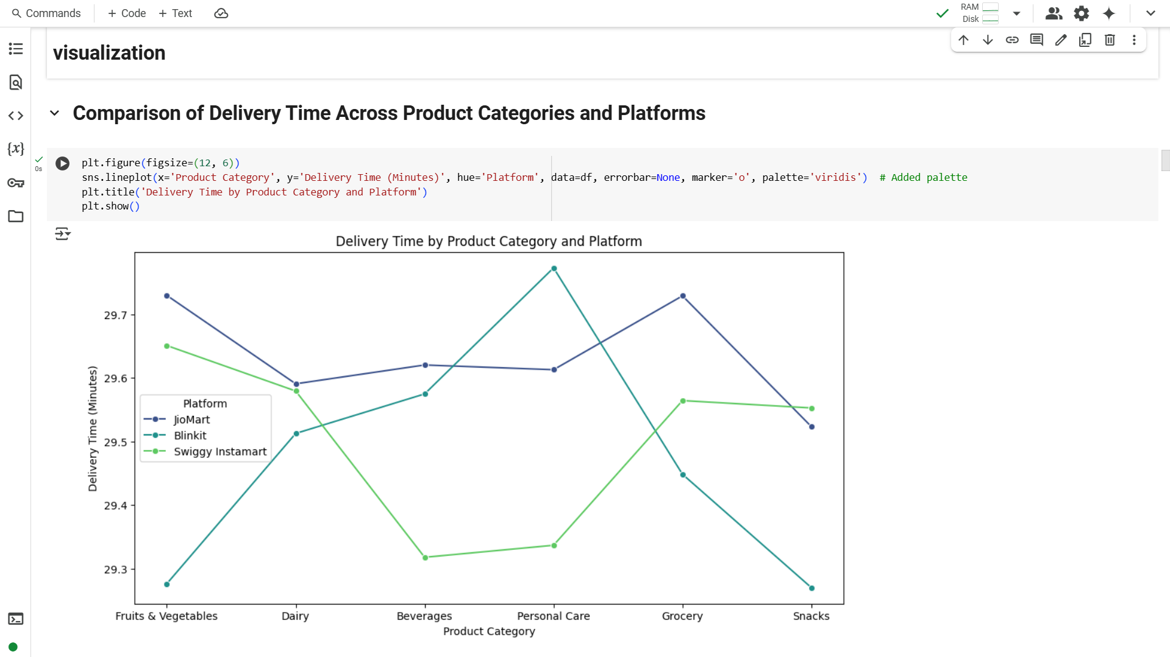

Slide 14
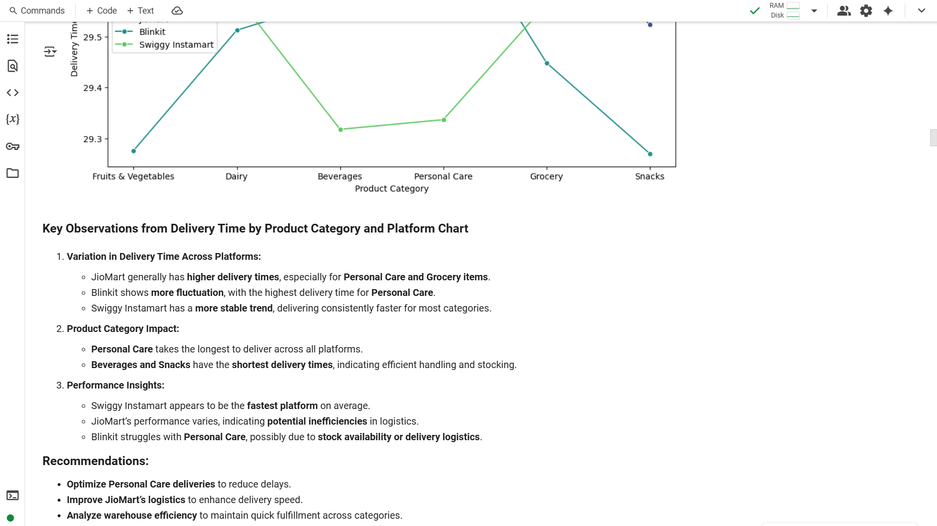

Slide 15
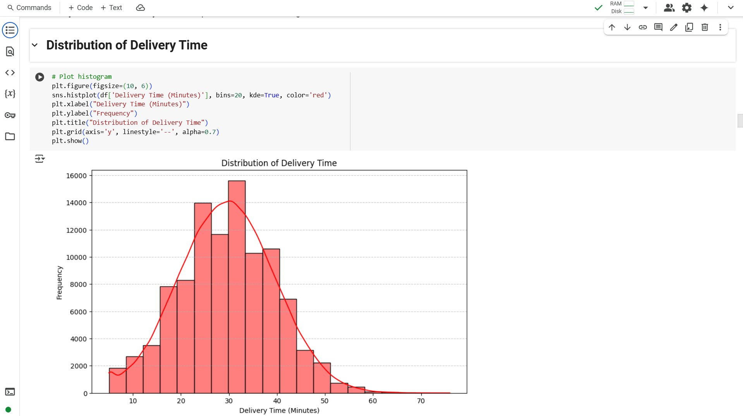

Slide 16
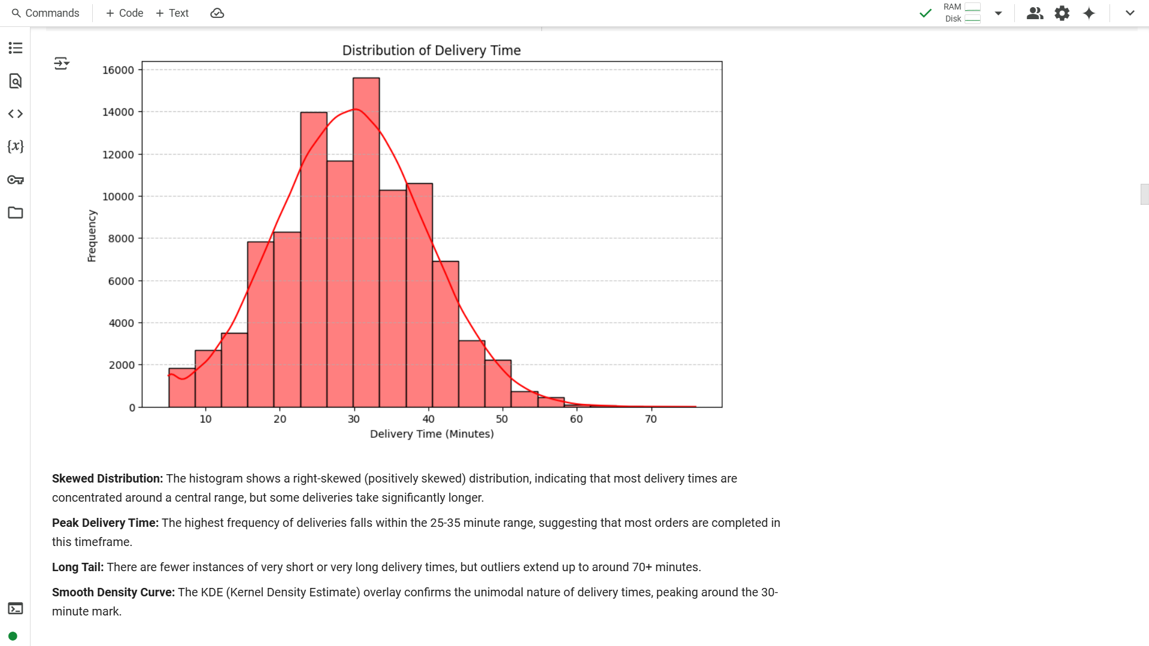

Slide 17
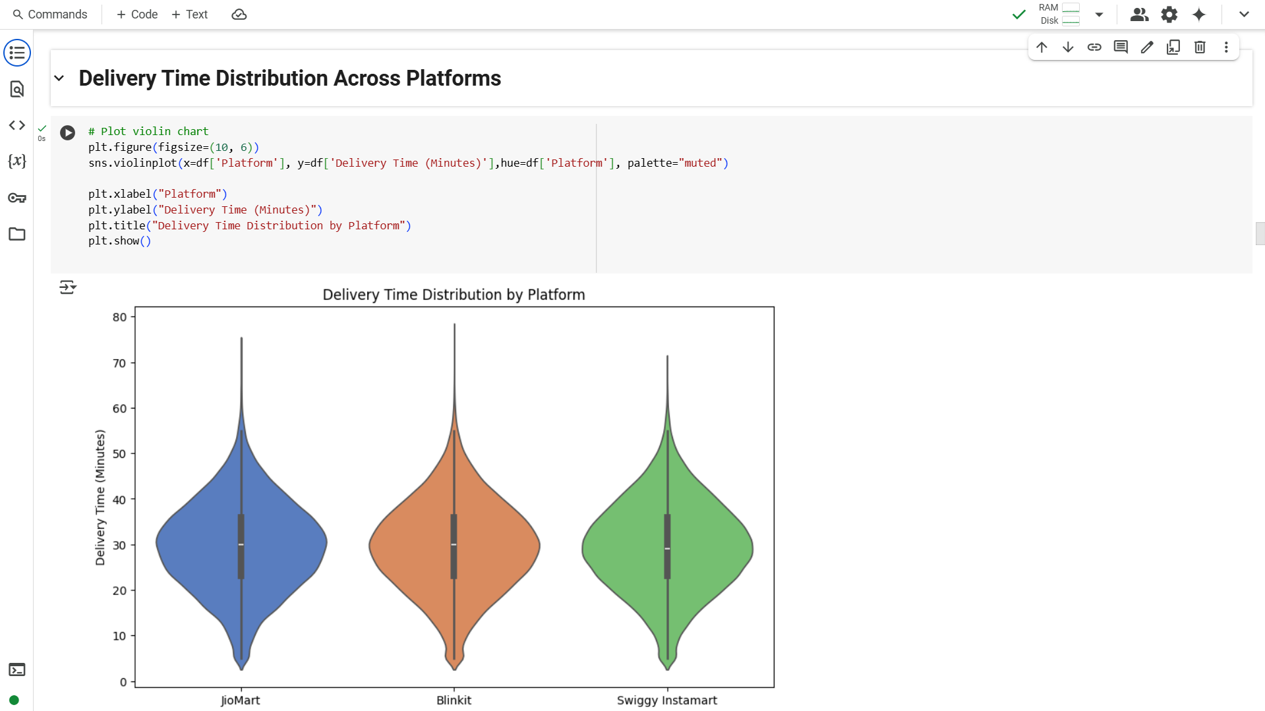

Slide 18
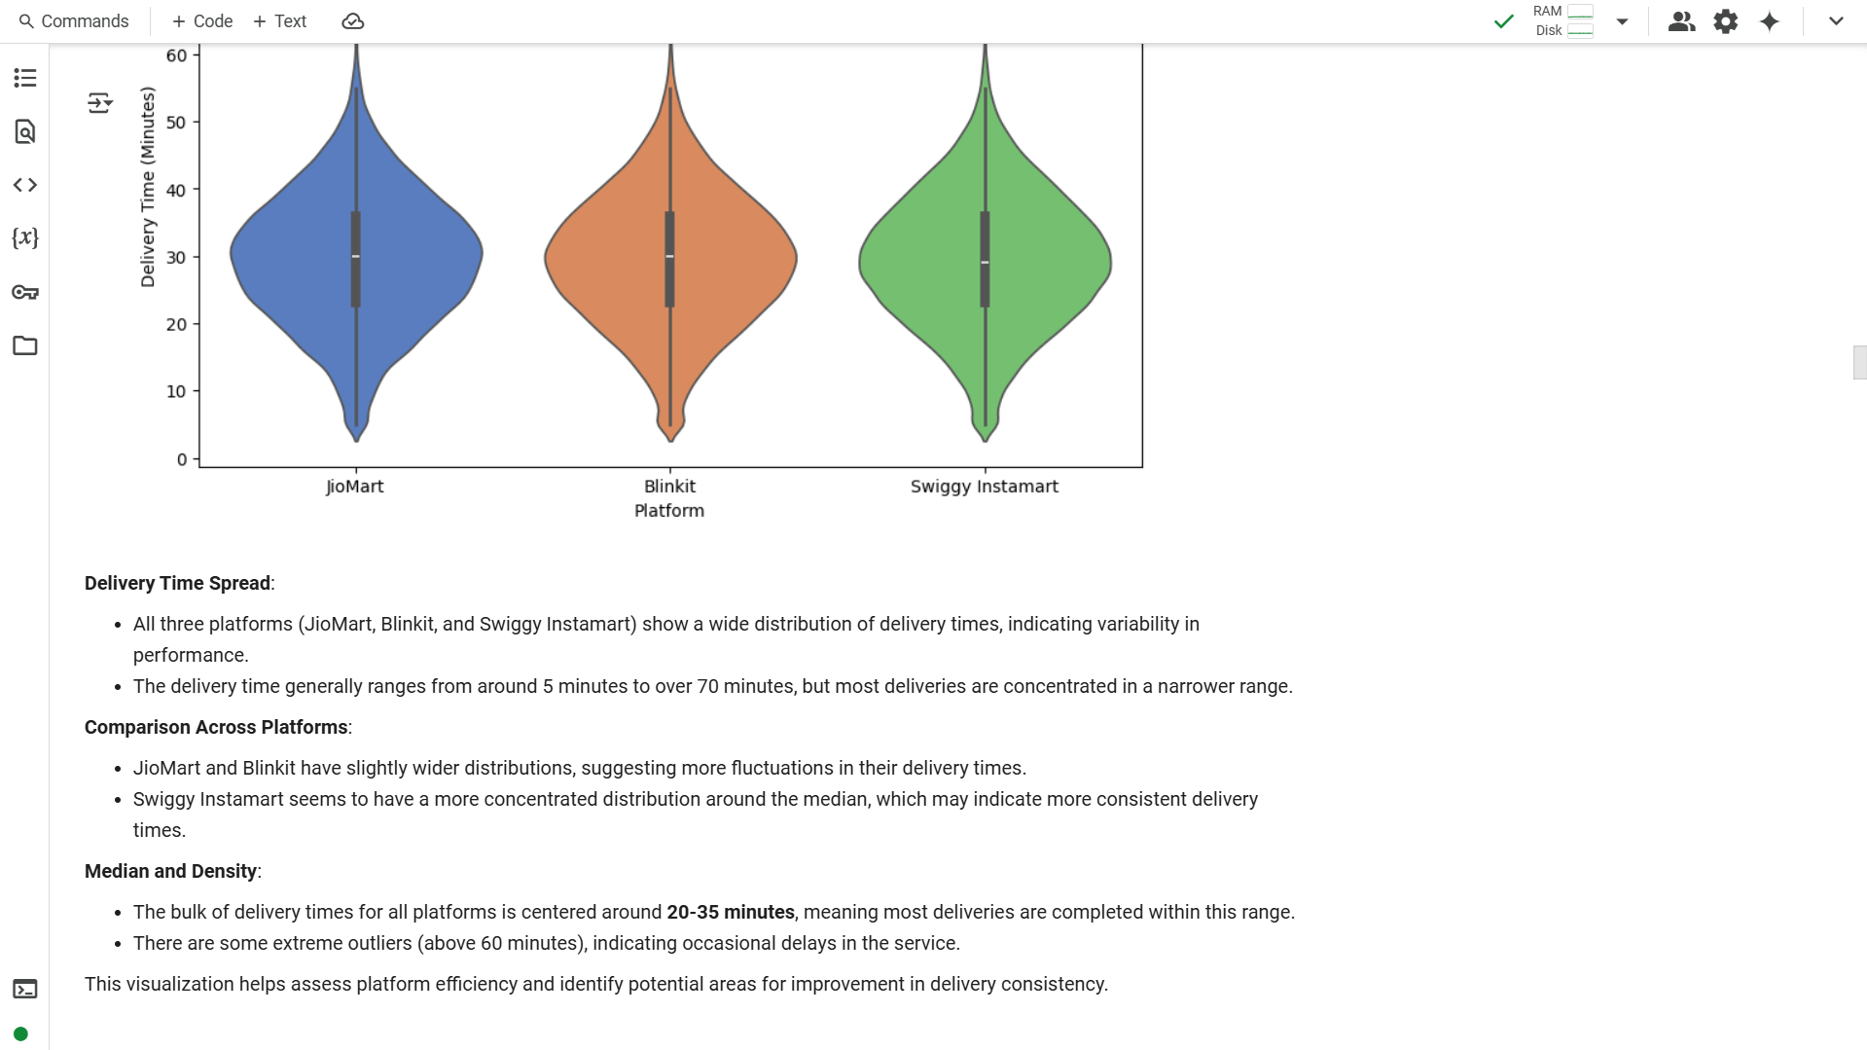

Slide 19
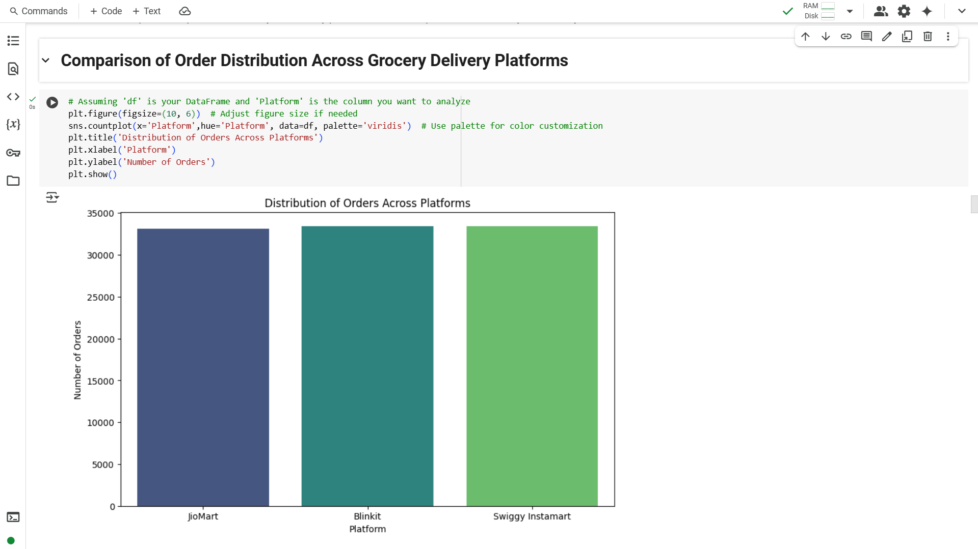

Slide 20
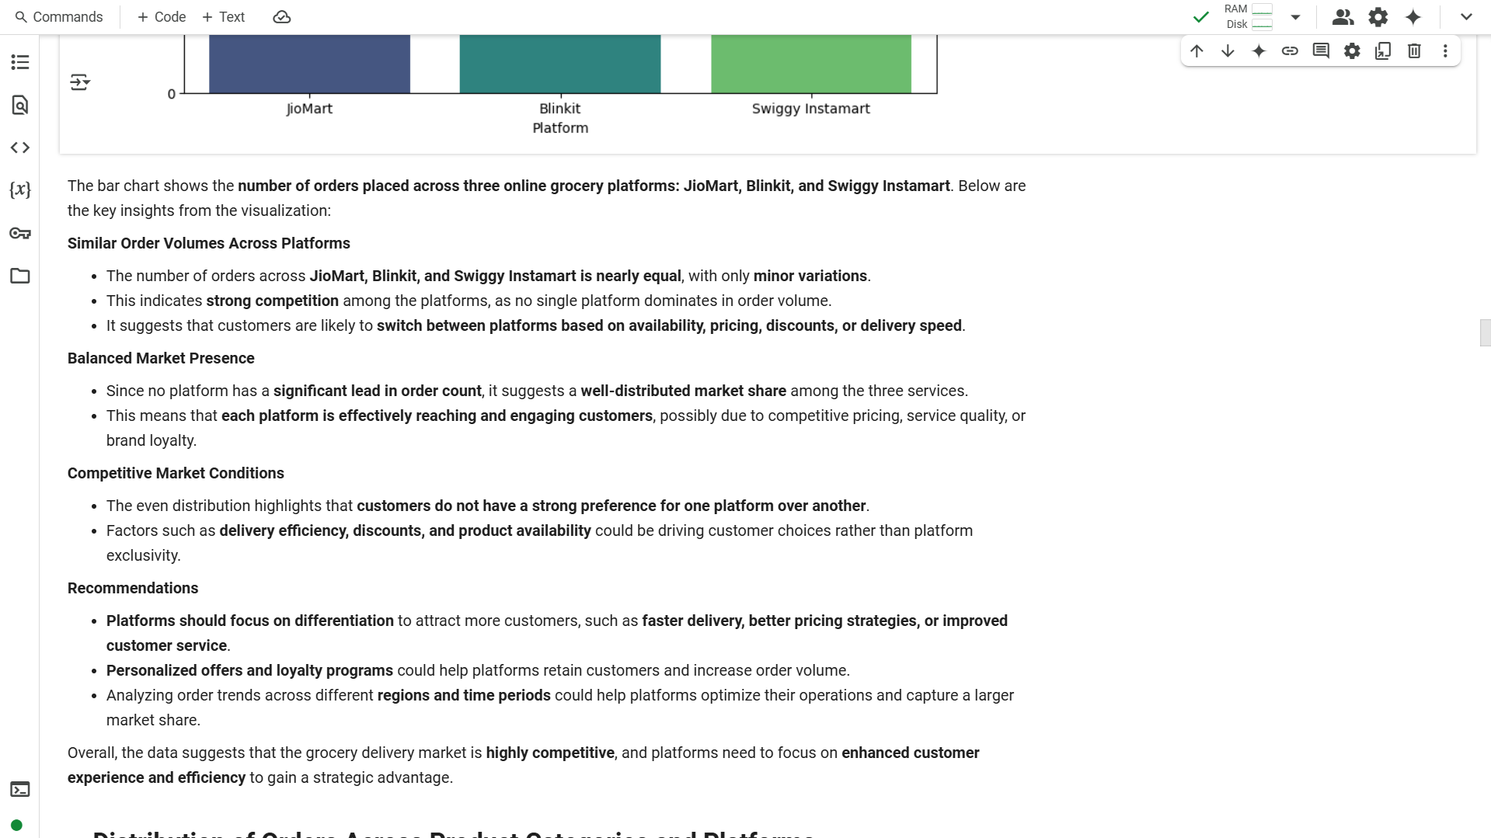

Slide 21
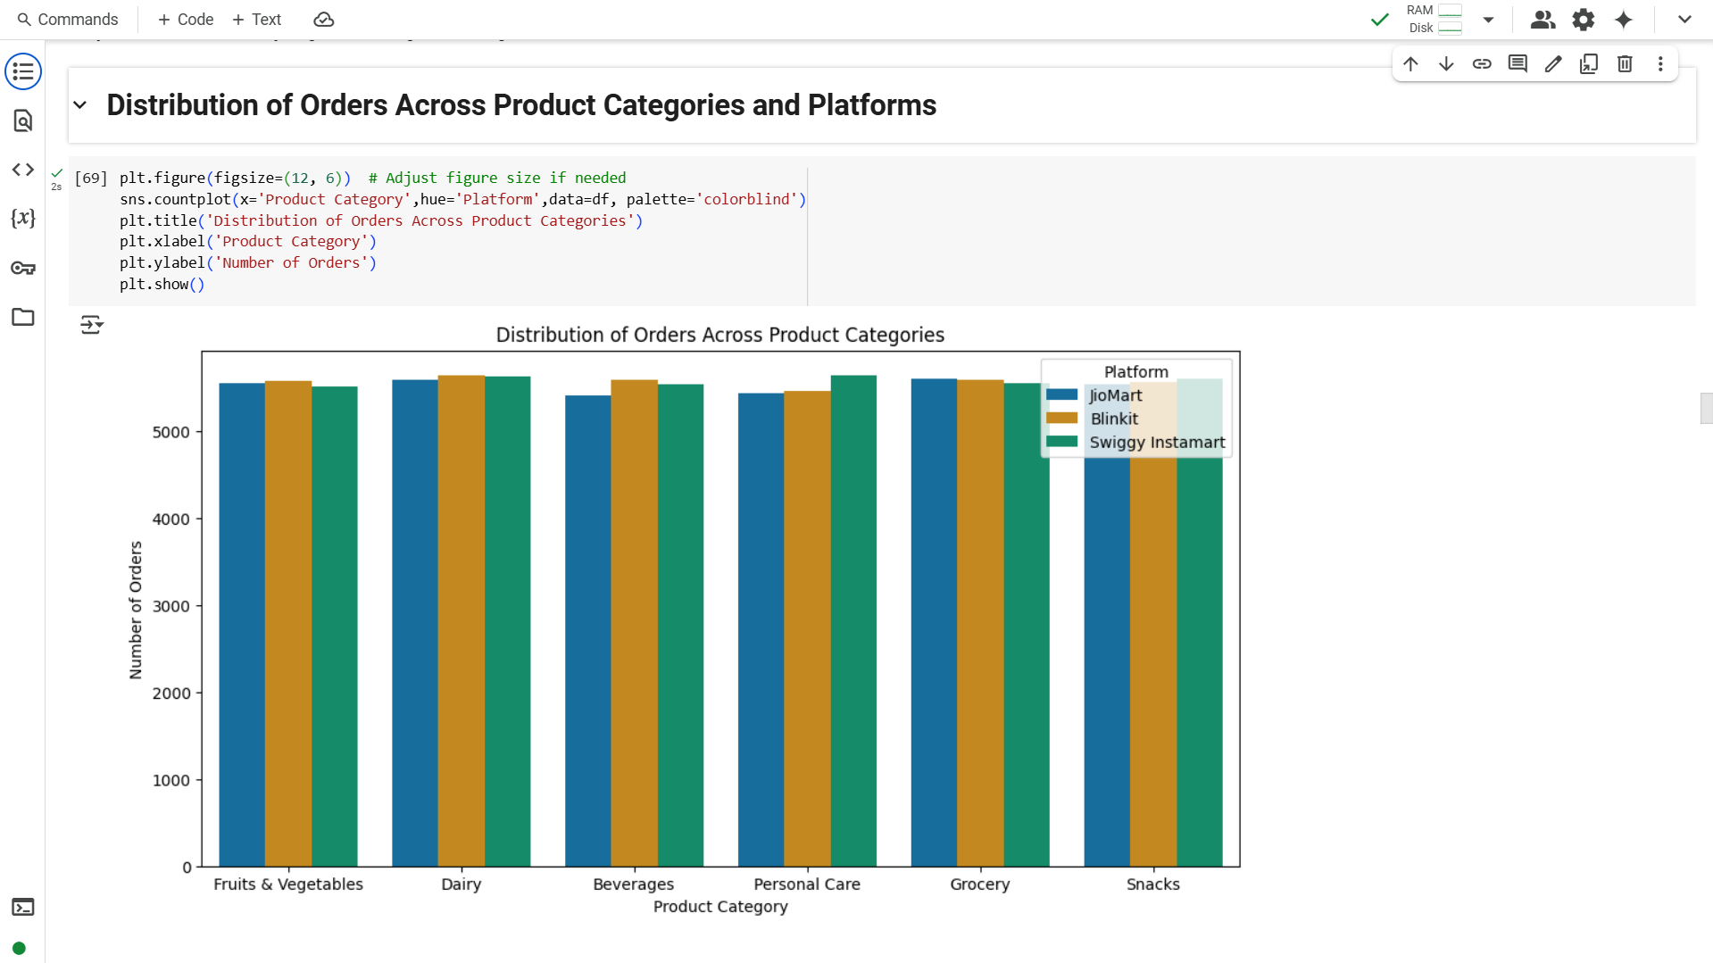

Slide 22
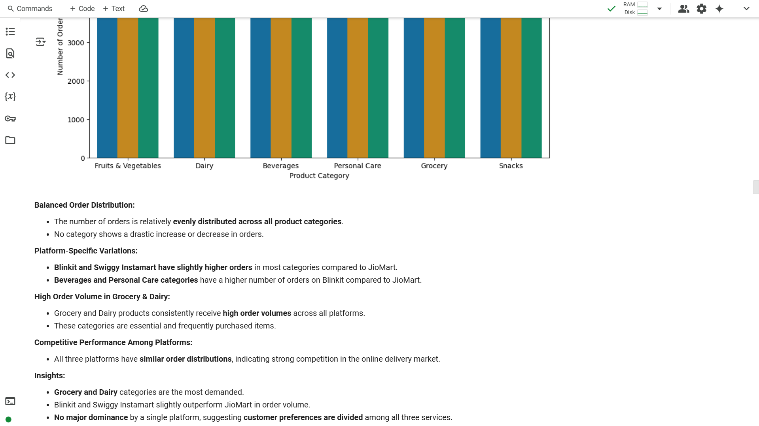

Slide 23
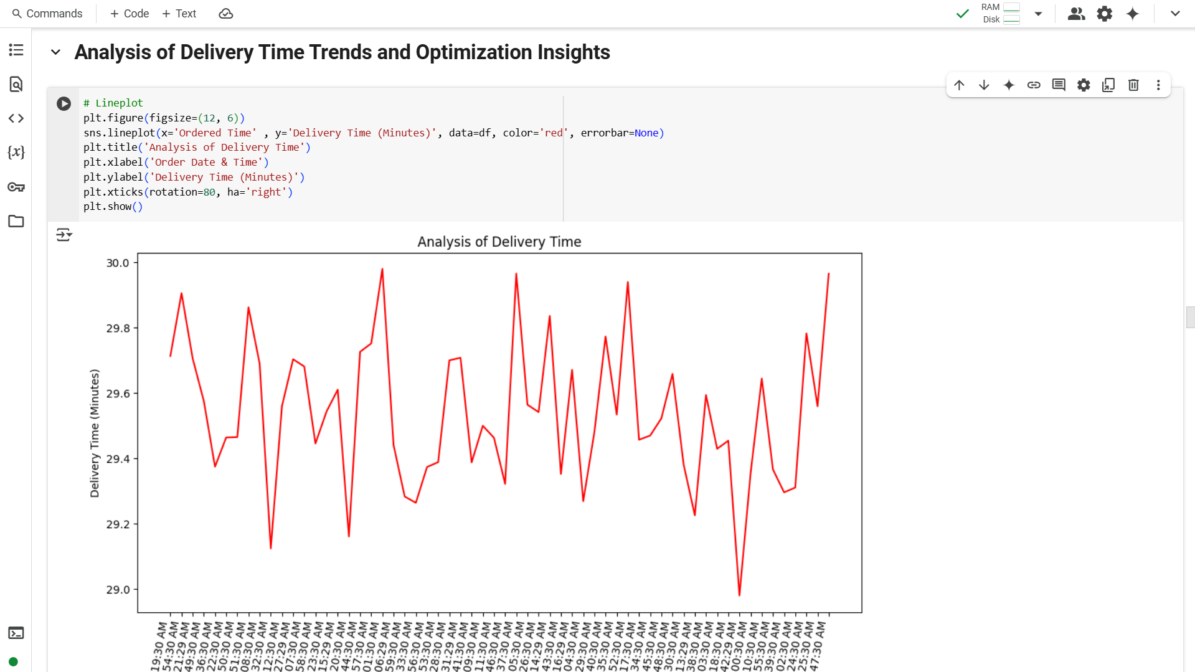

Slide 24
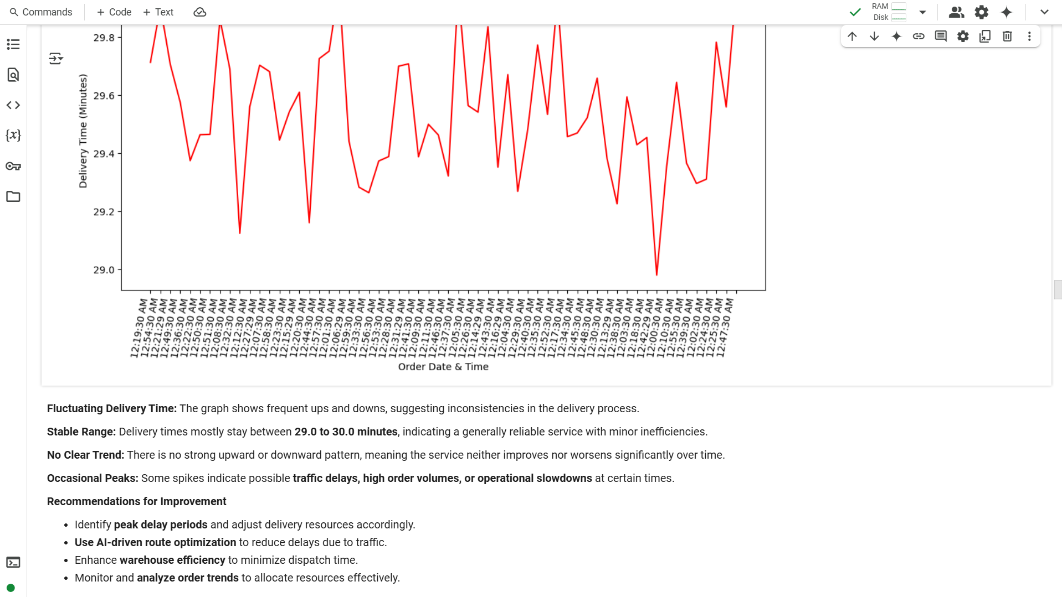

Slide 25
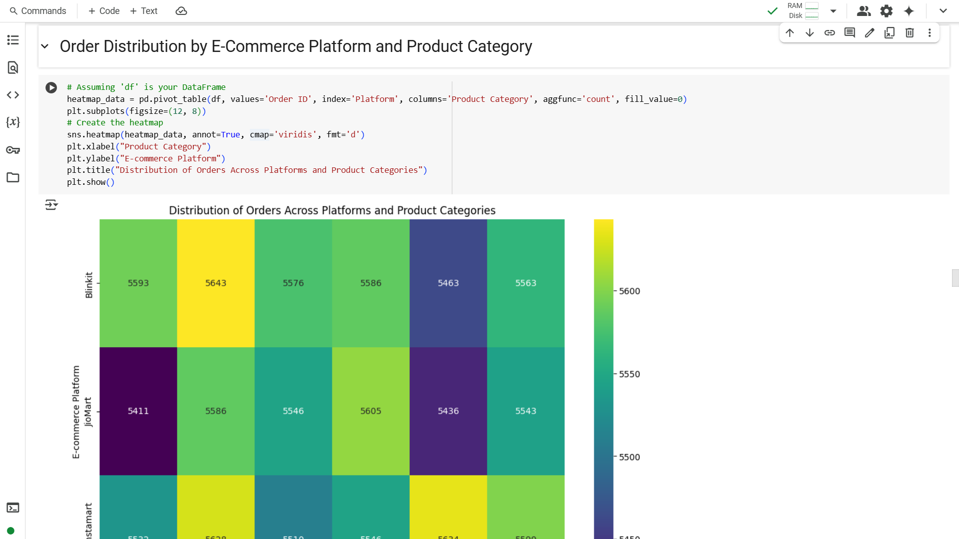

Slide 26
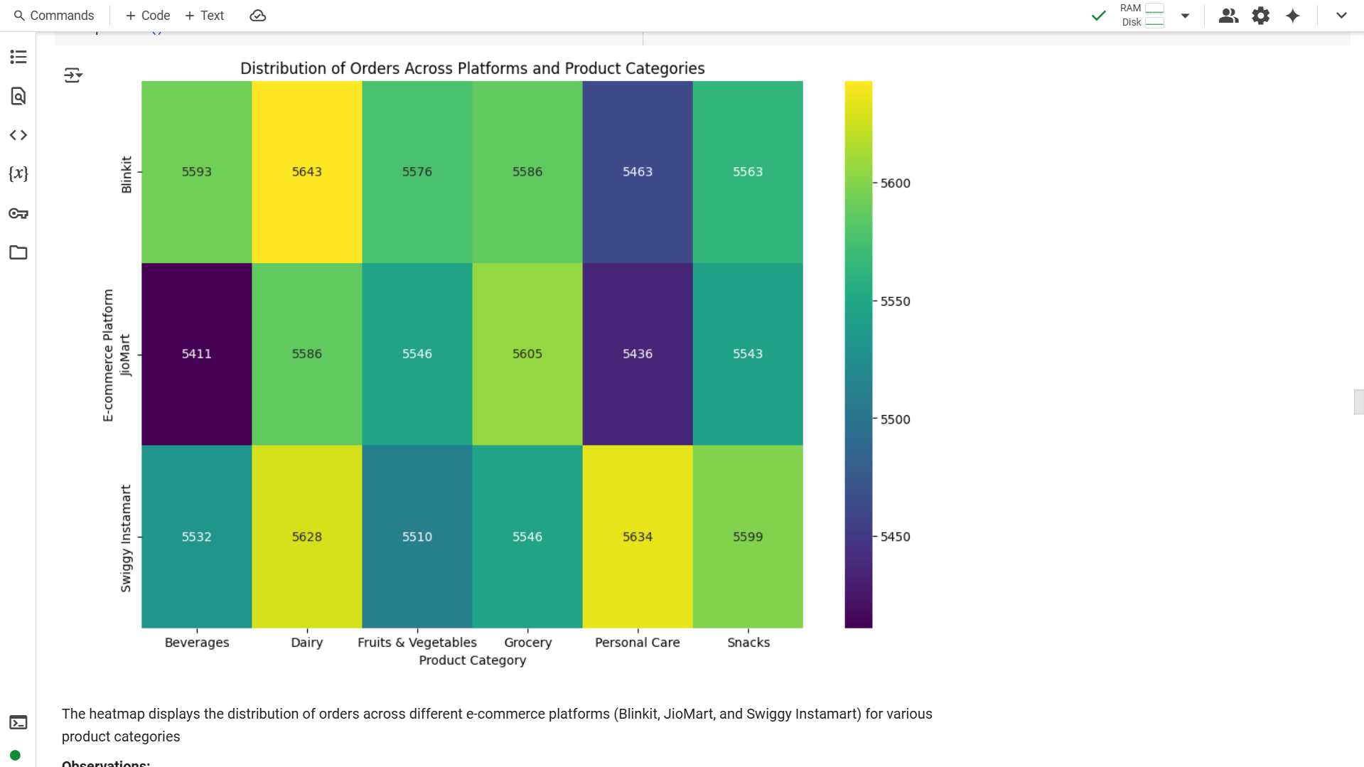

Slide 27
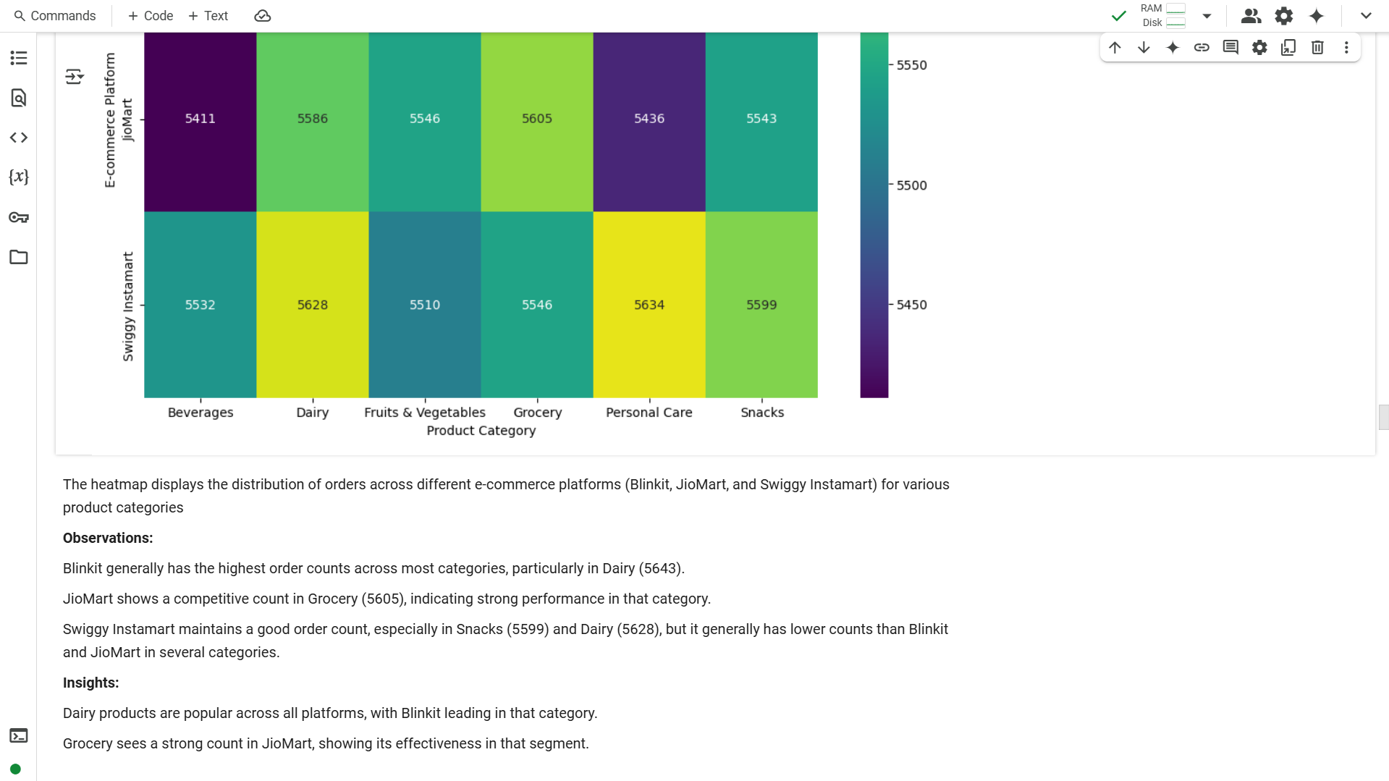

Slide 28
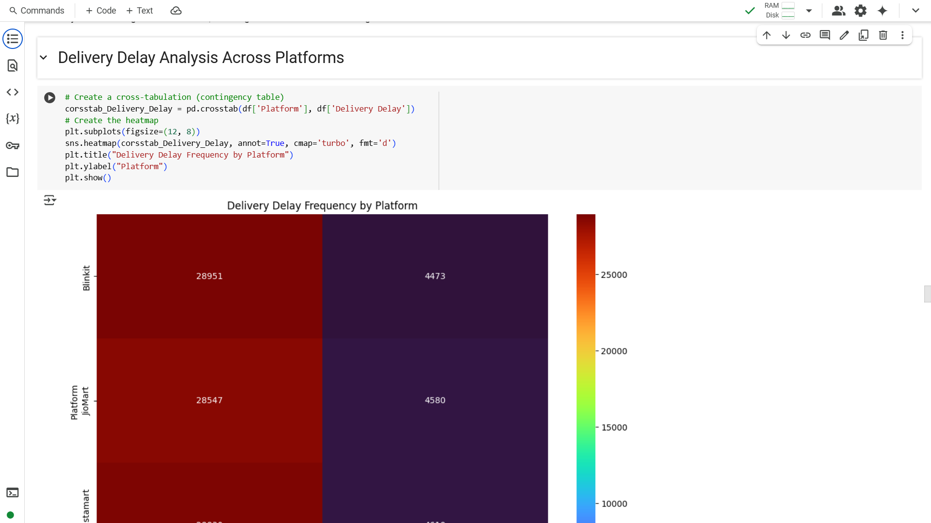

Slide 29
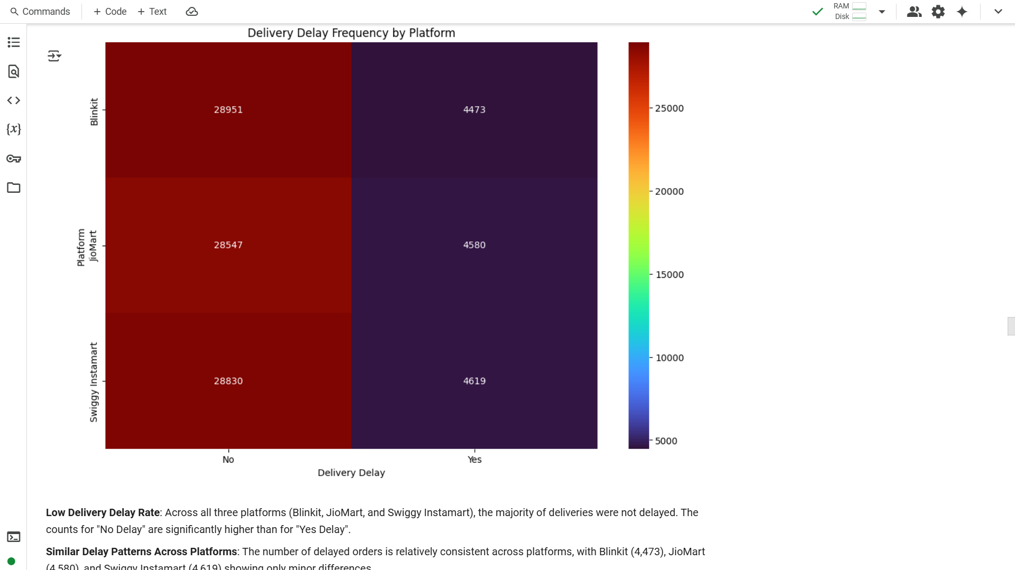

Slide 30
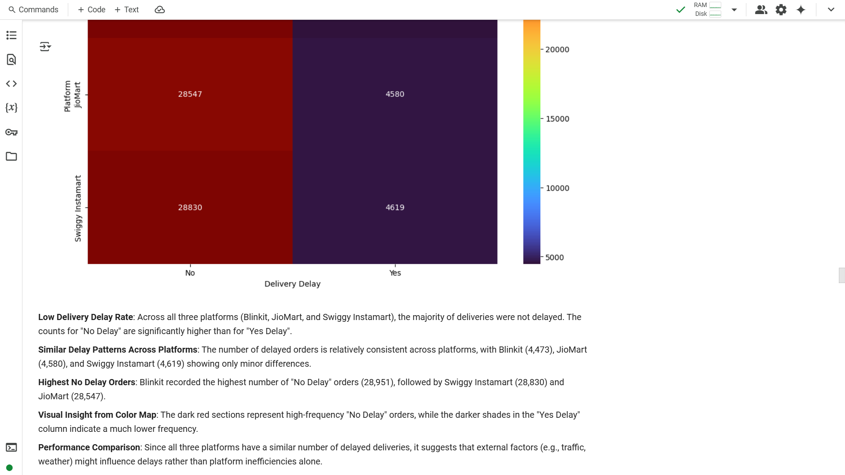

Slide 31
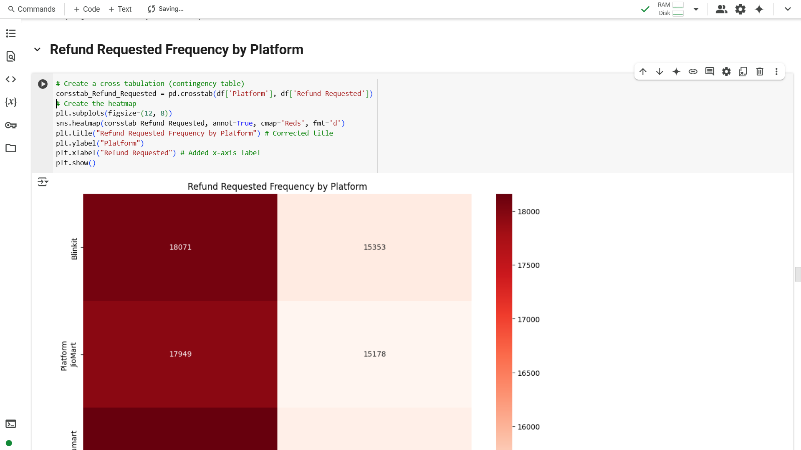

Slide 32
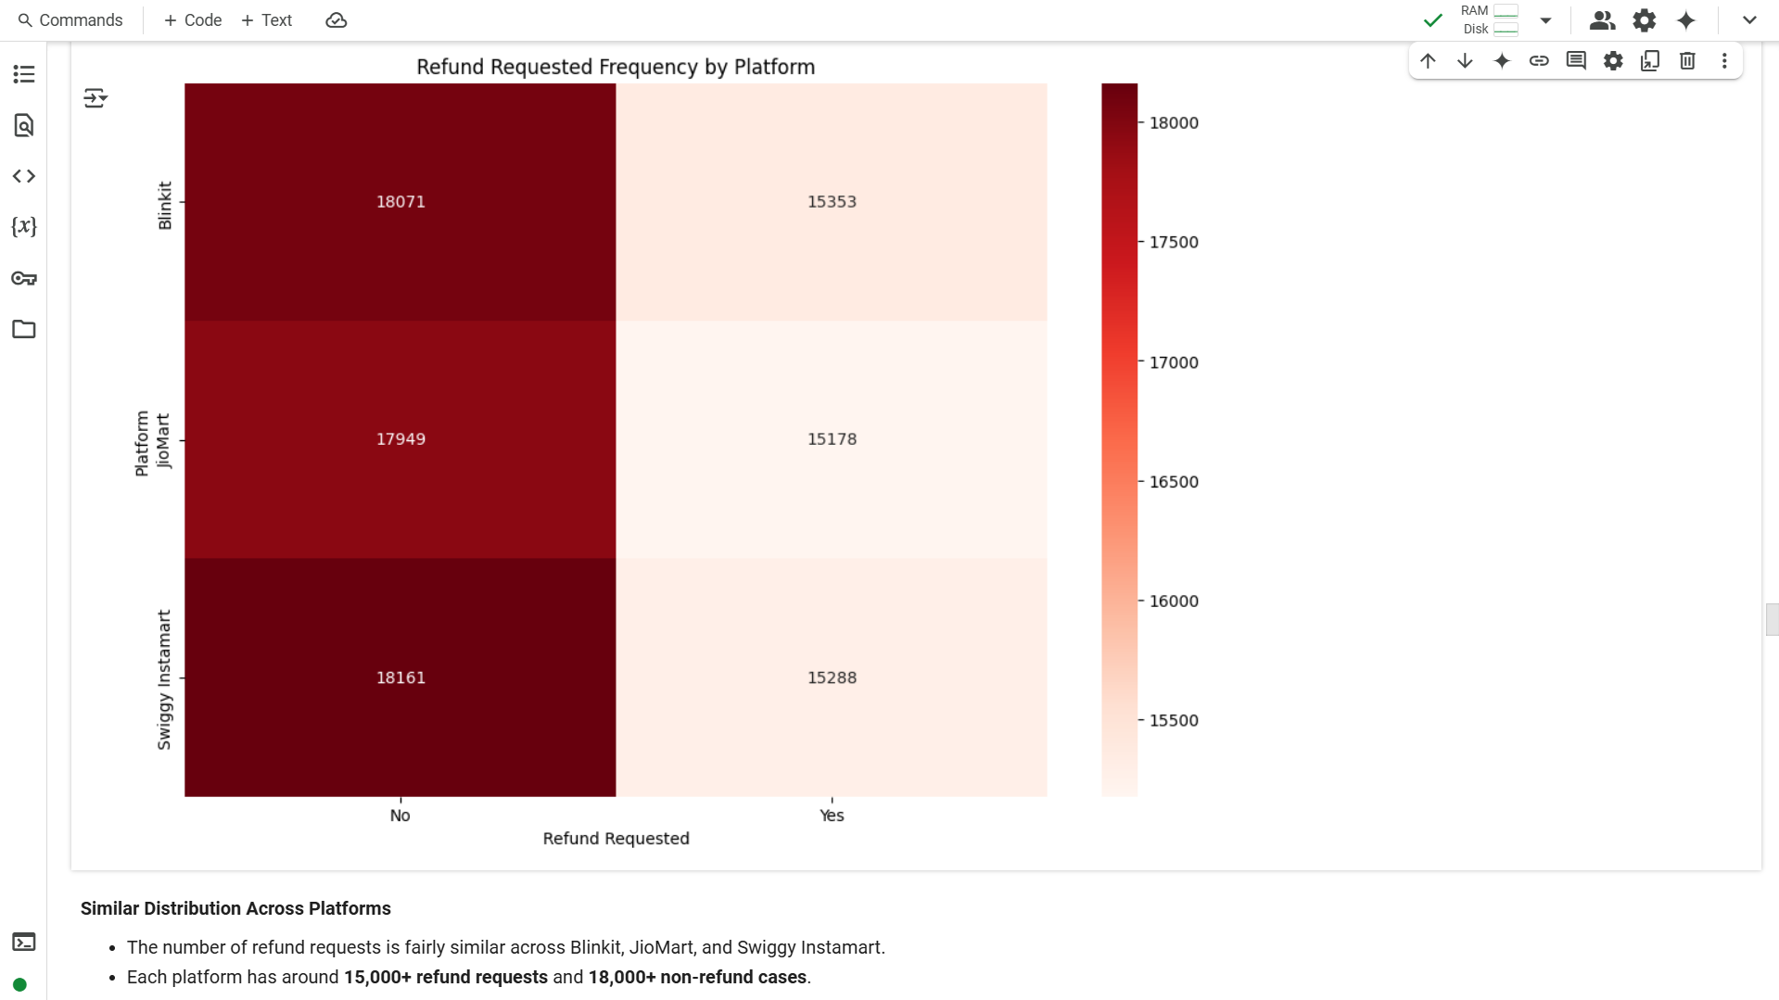

Slide 33
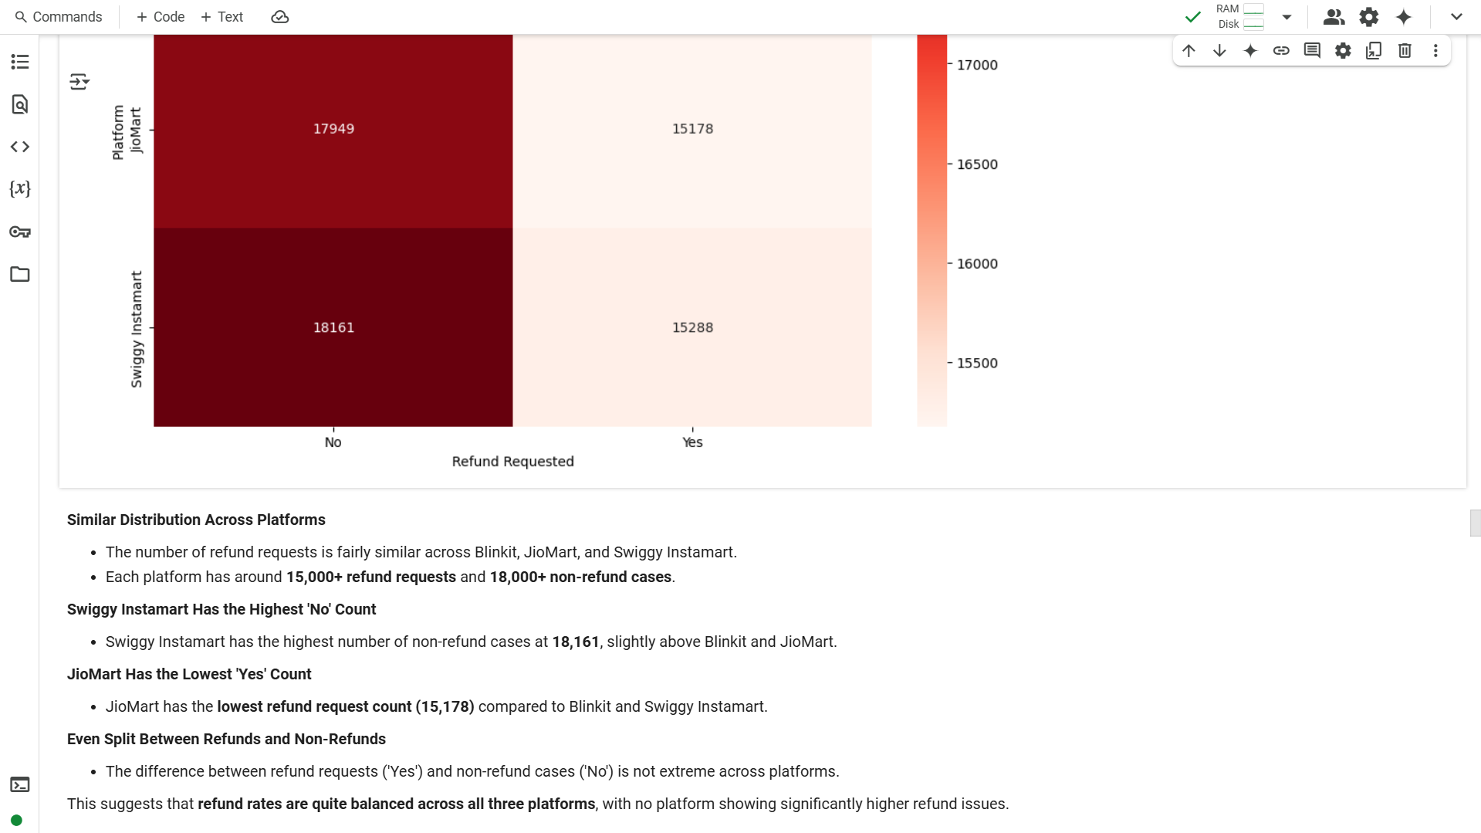

Slide 34
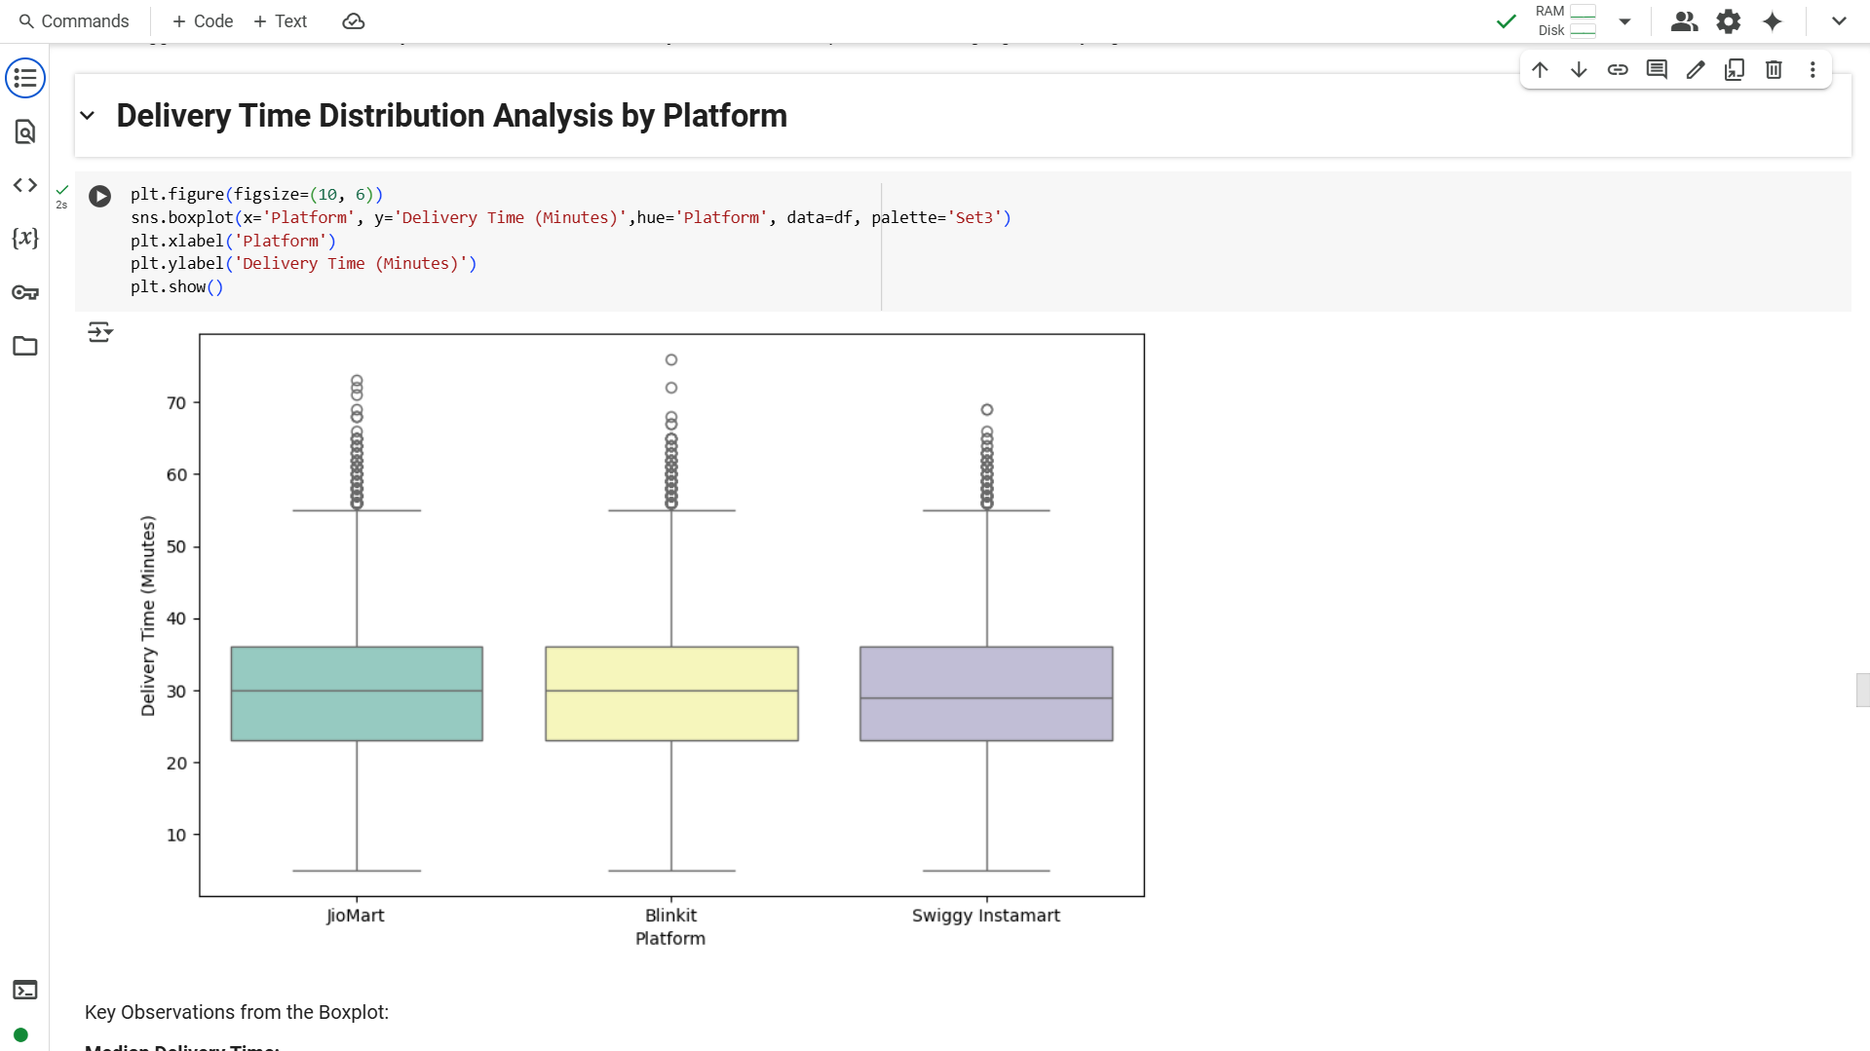

Slide 35
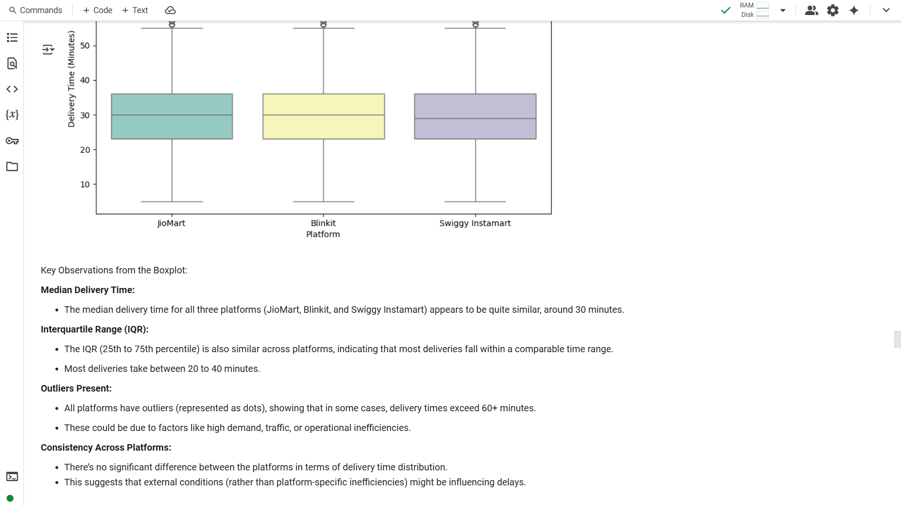

Slide 36
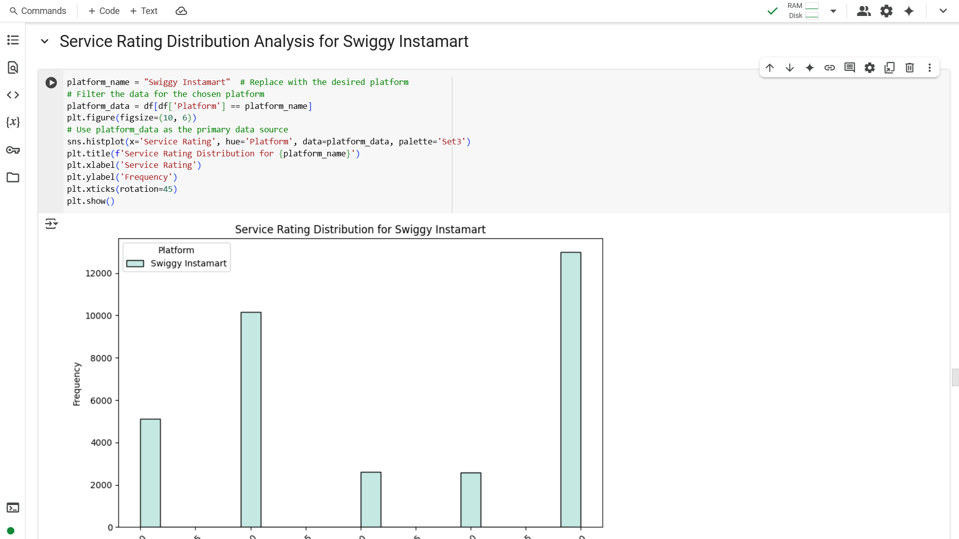

Slide 37
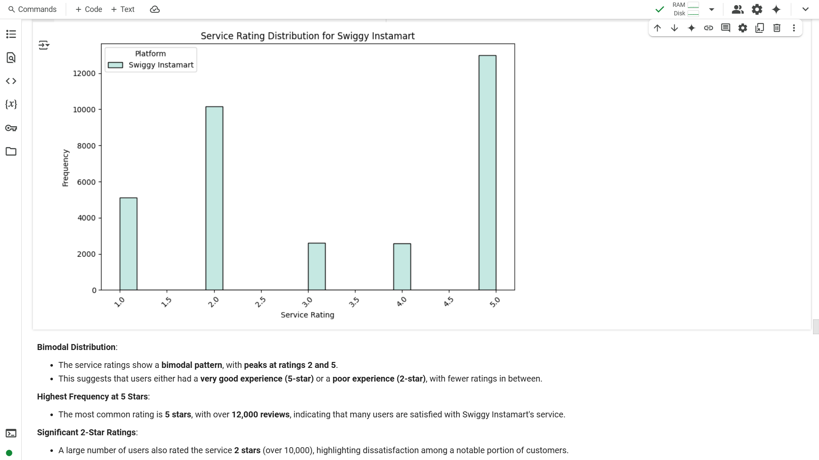

Slide 38
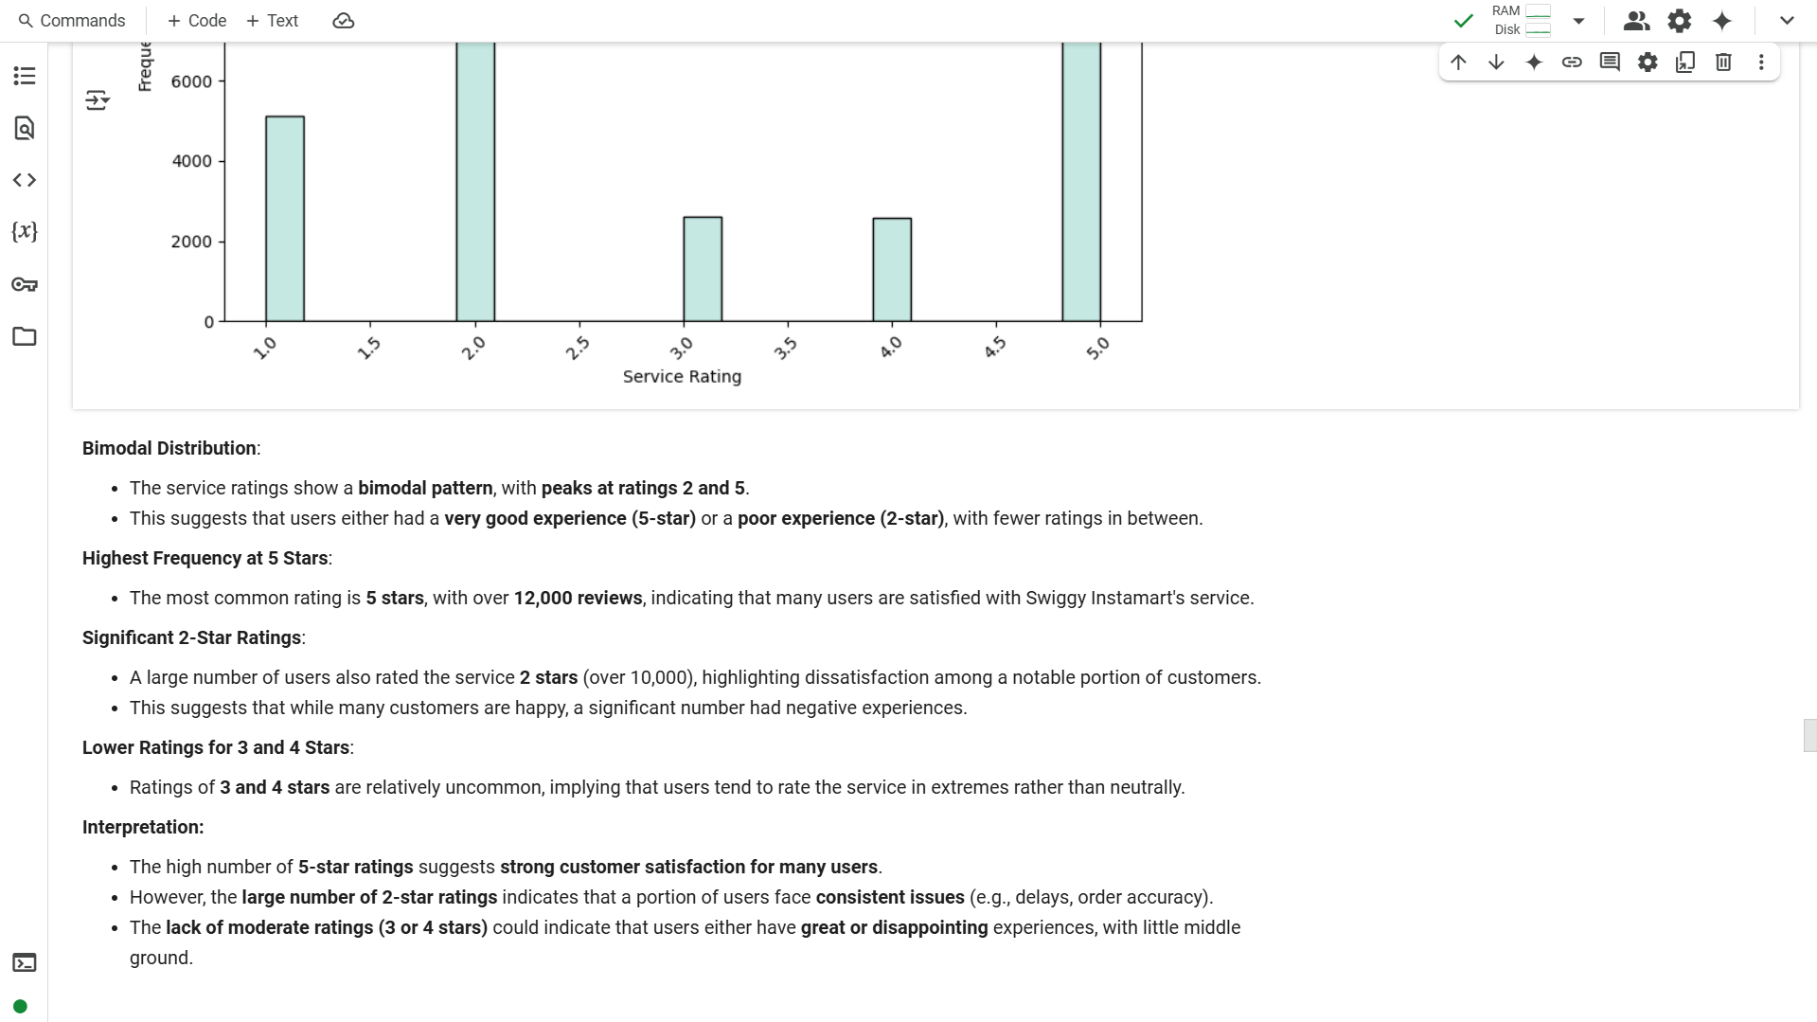

Slide 39
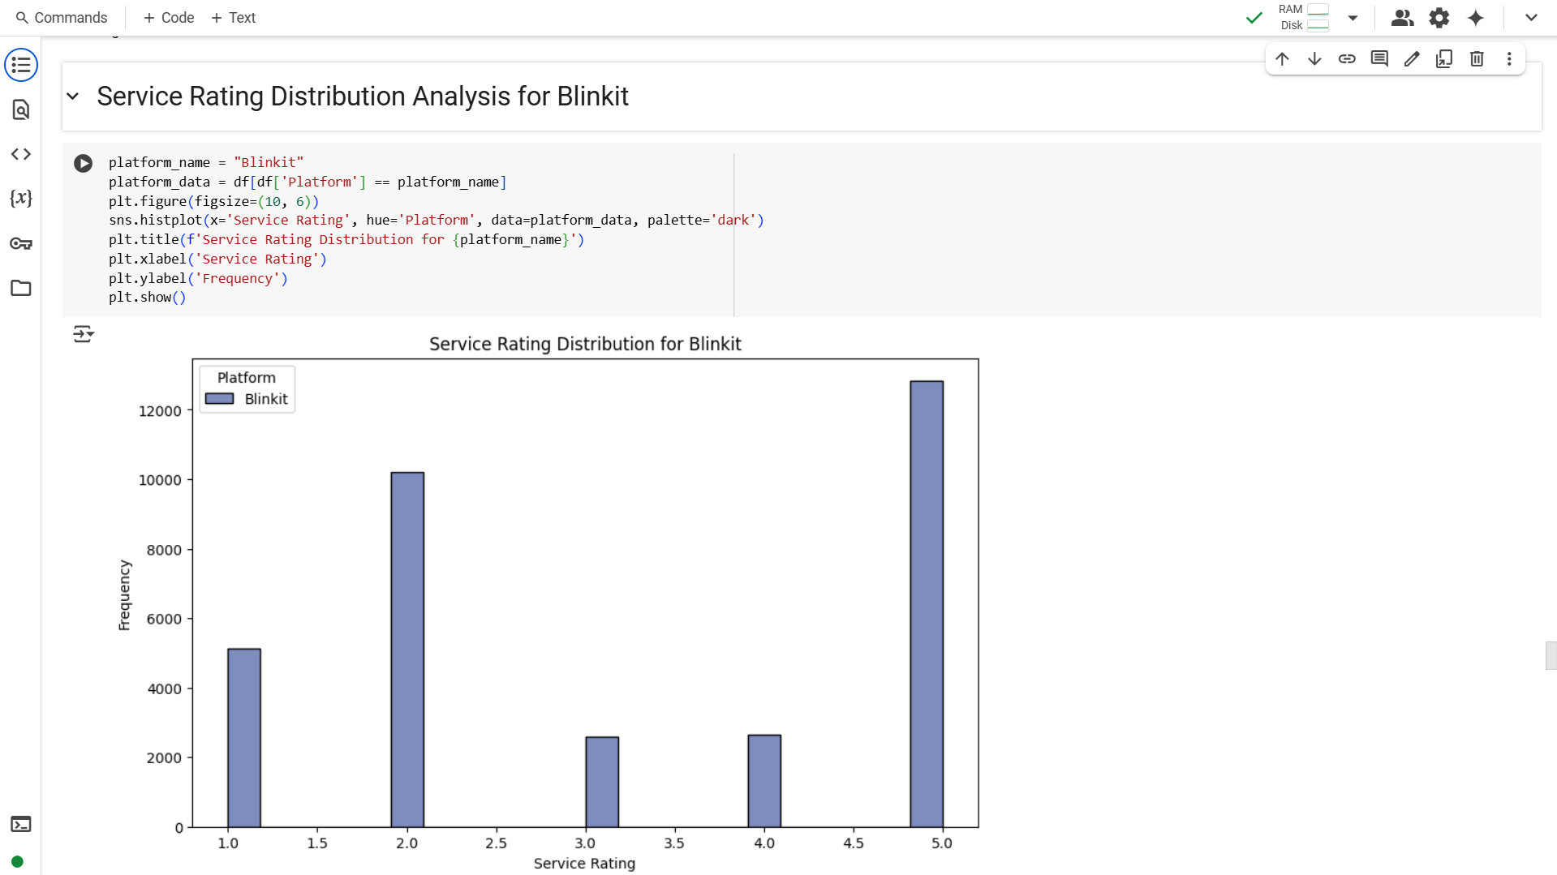

Slide 40
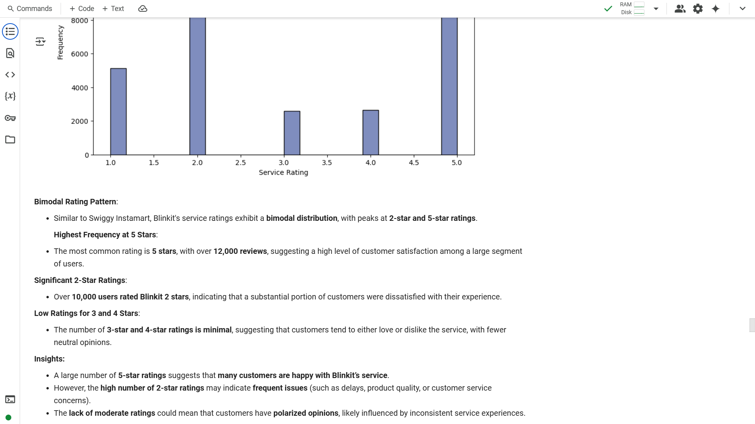

Slide 41
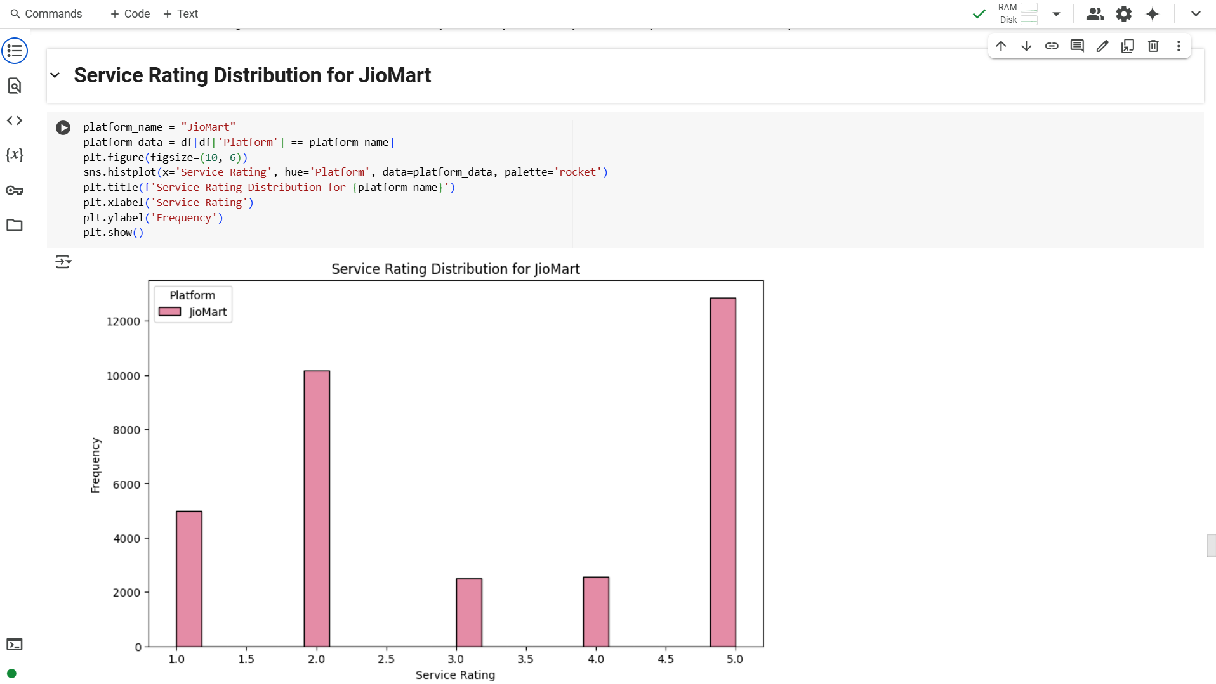

Slide 42
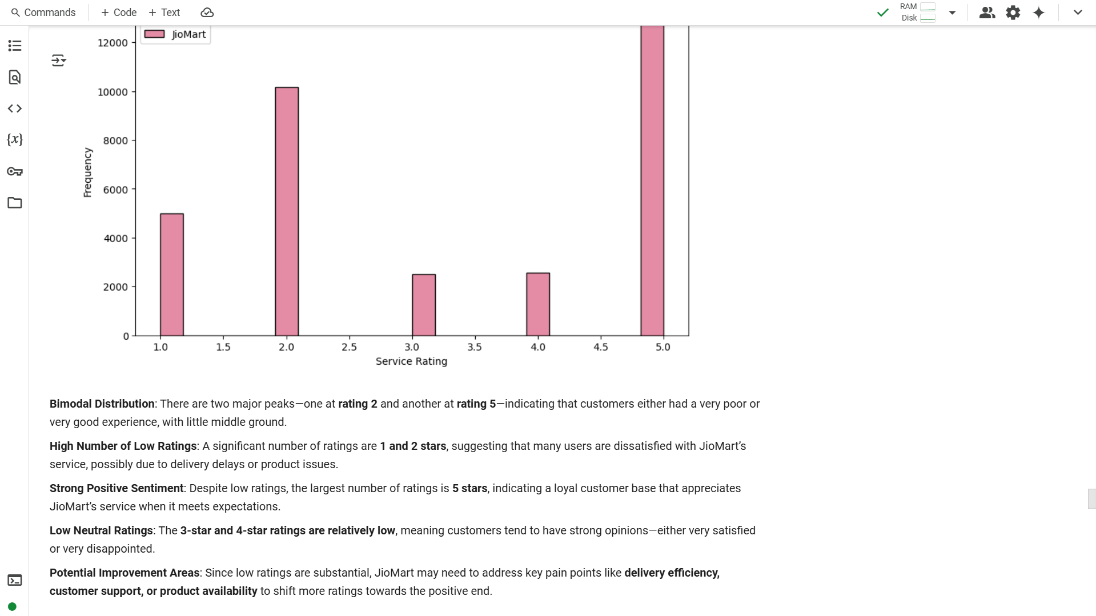

Slide 43
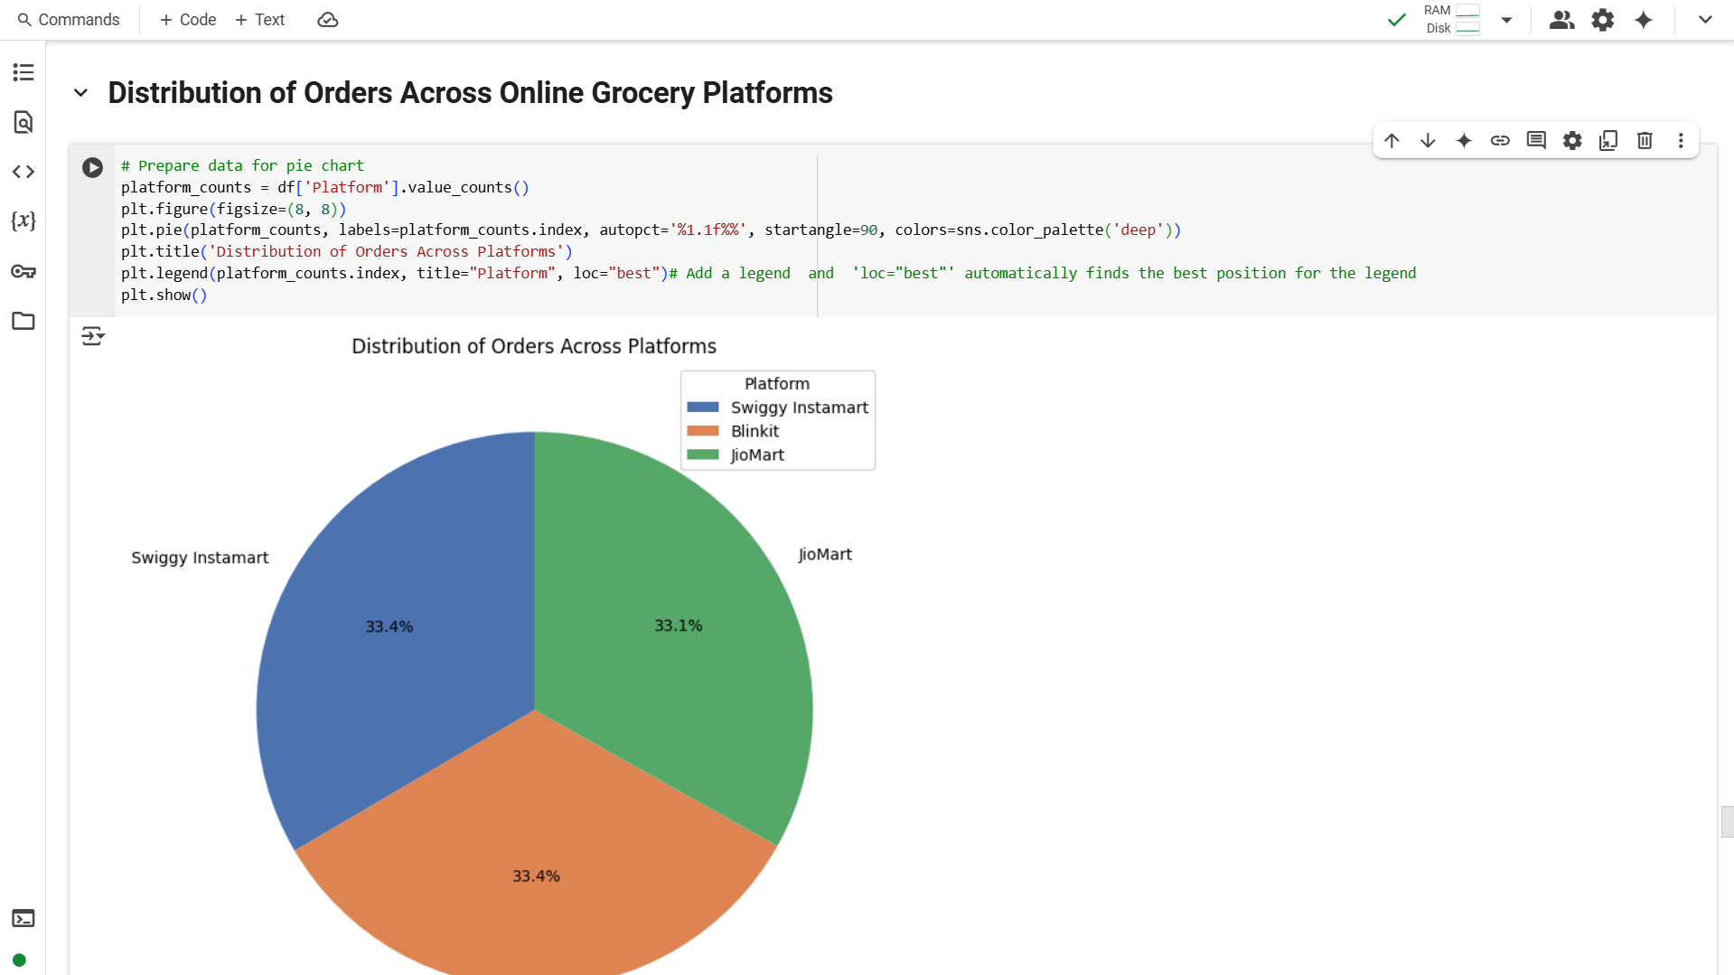

Slide 44
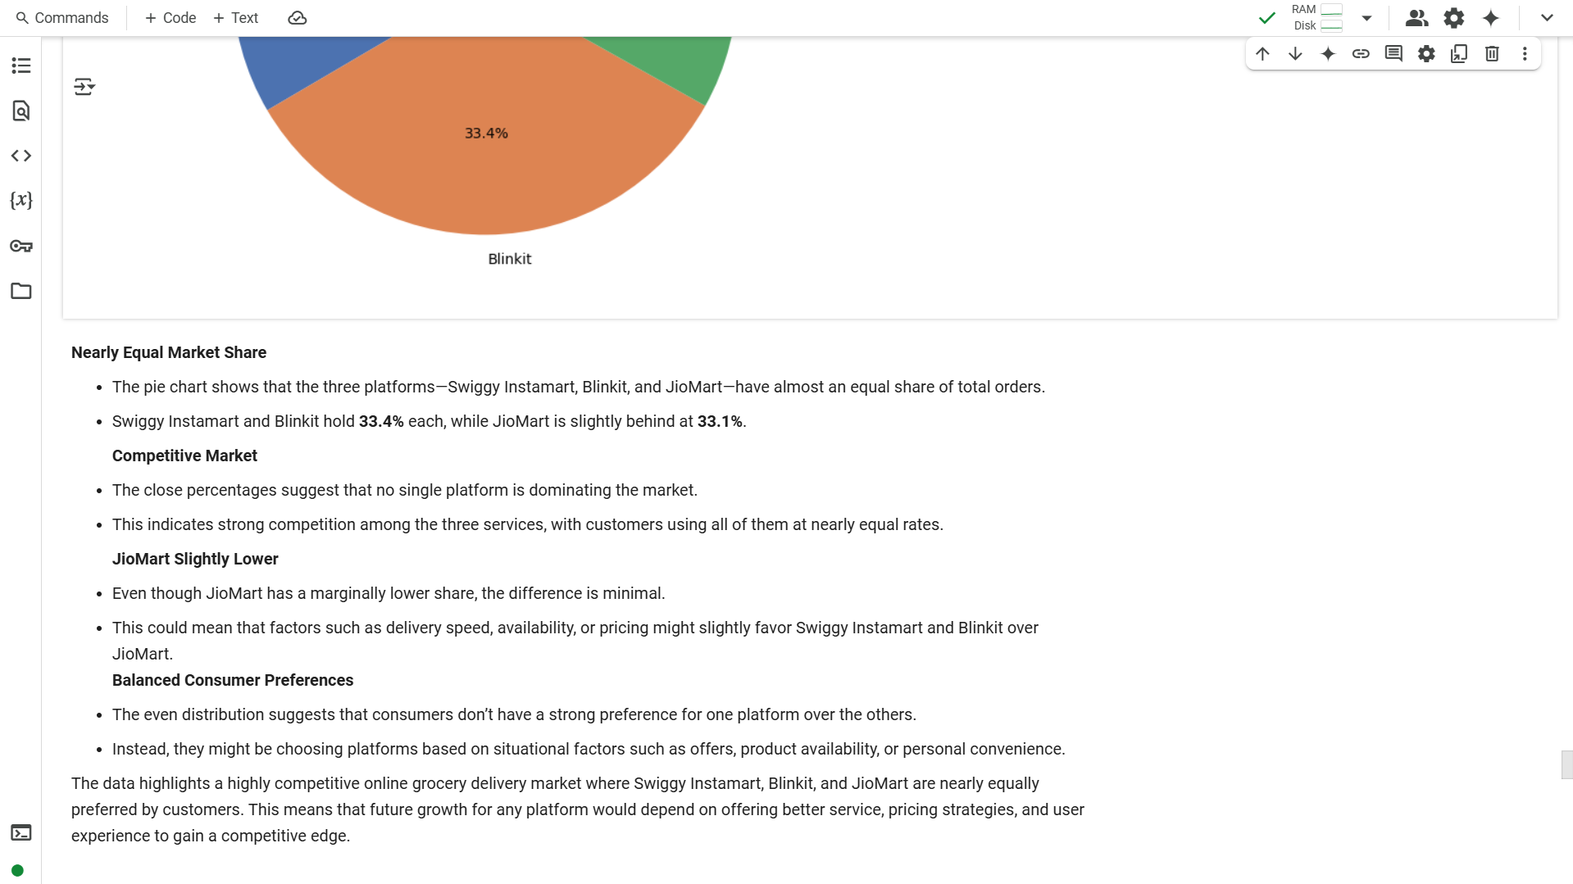

Slide 45
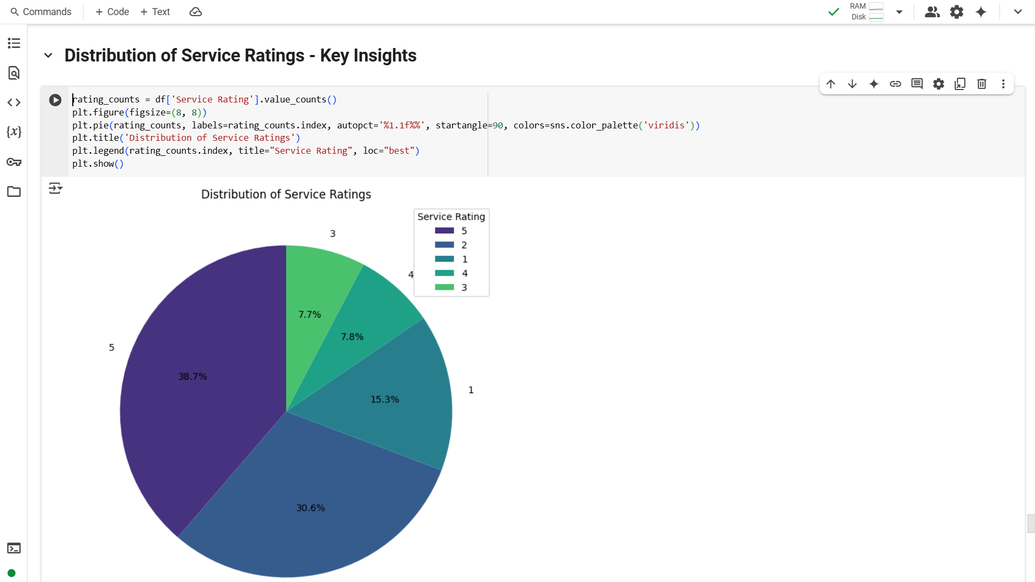

Slide 46
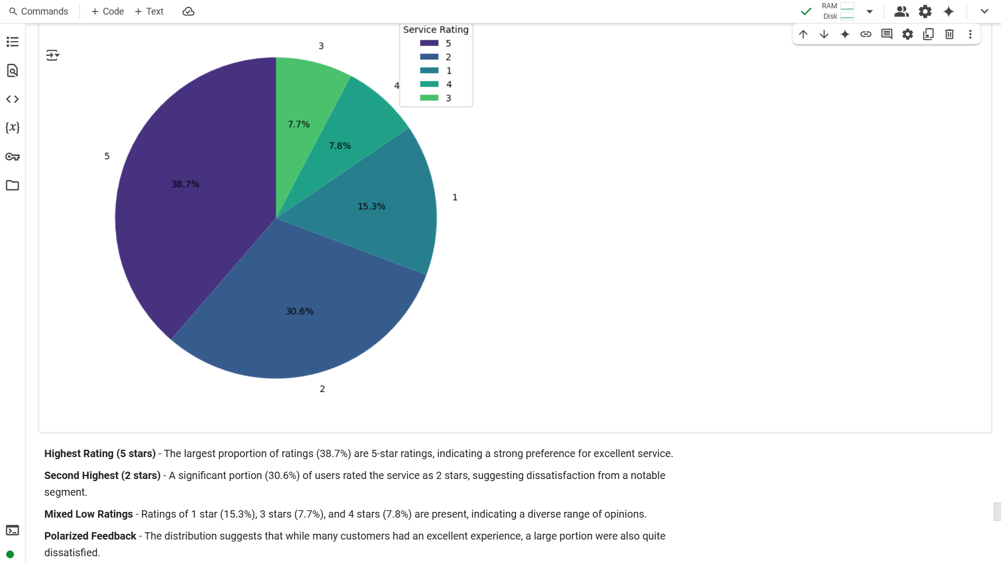

Slide 47
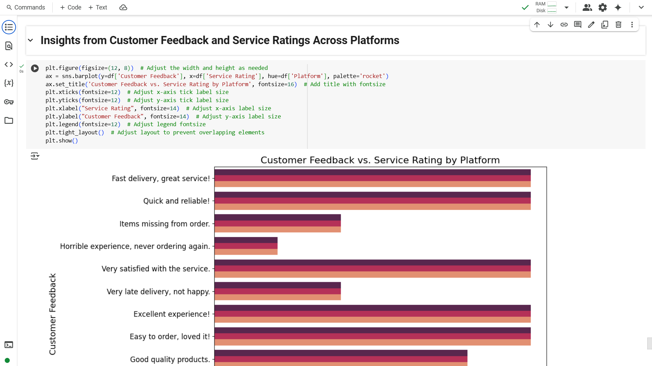

Slide 48
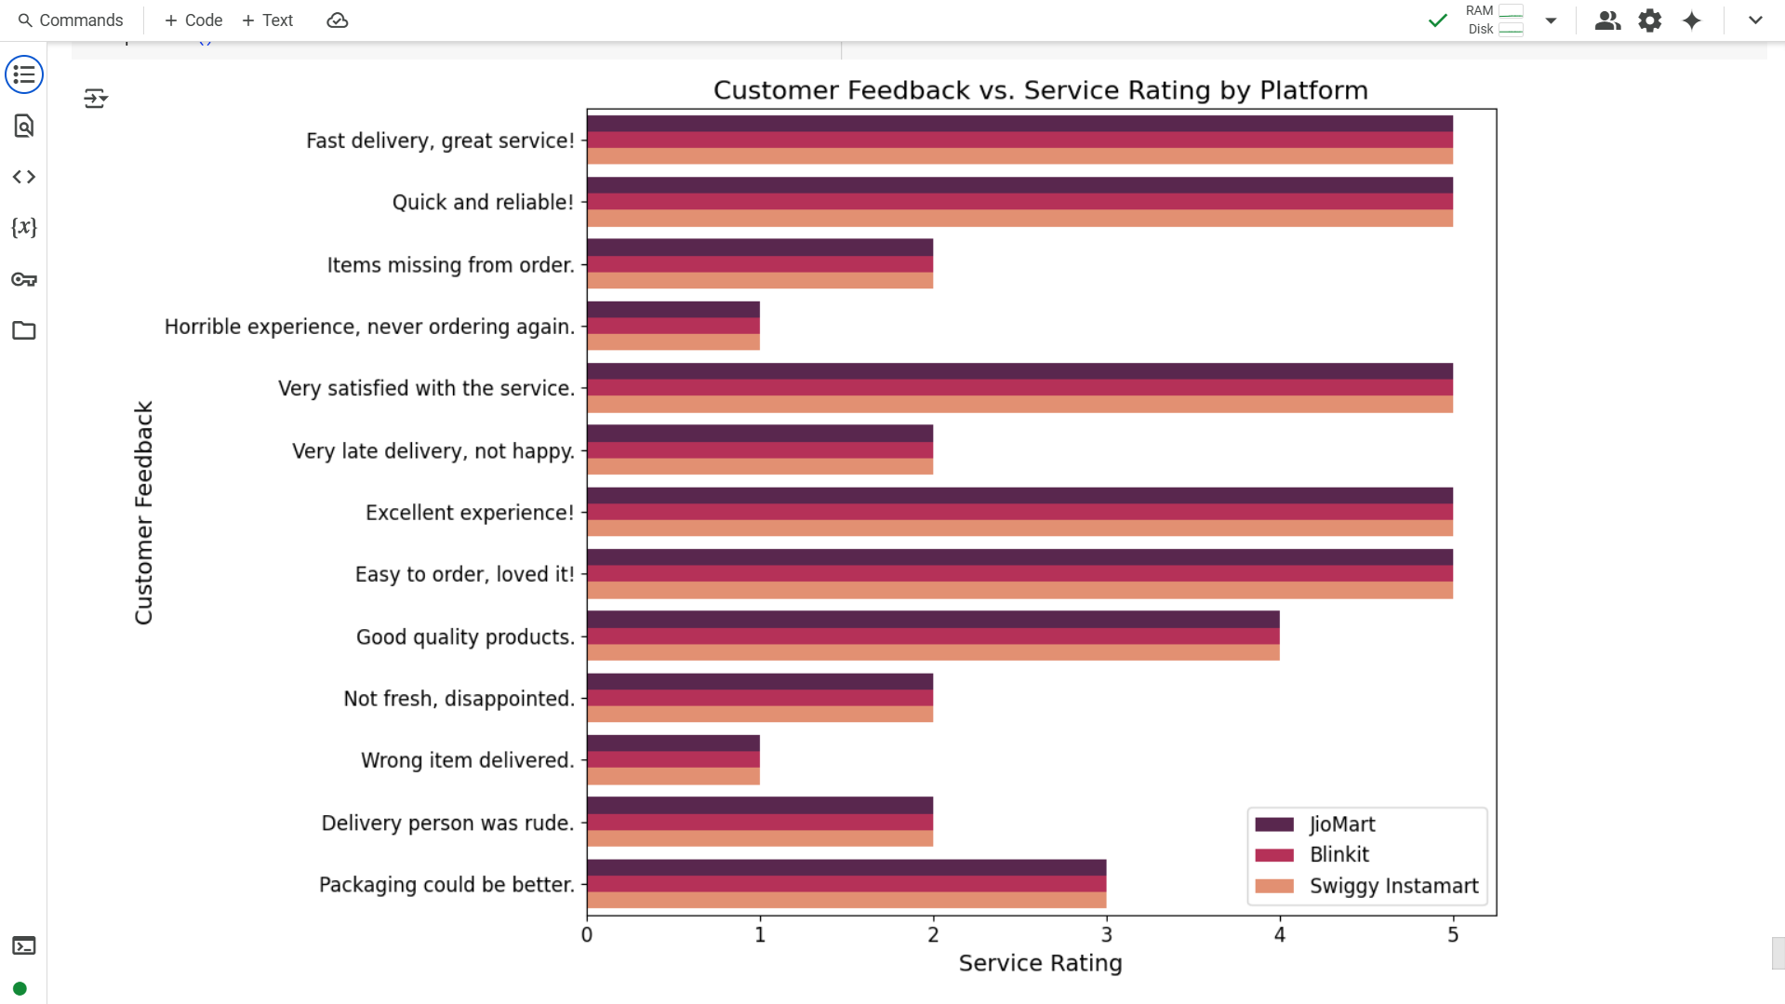

Slide 49
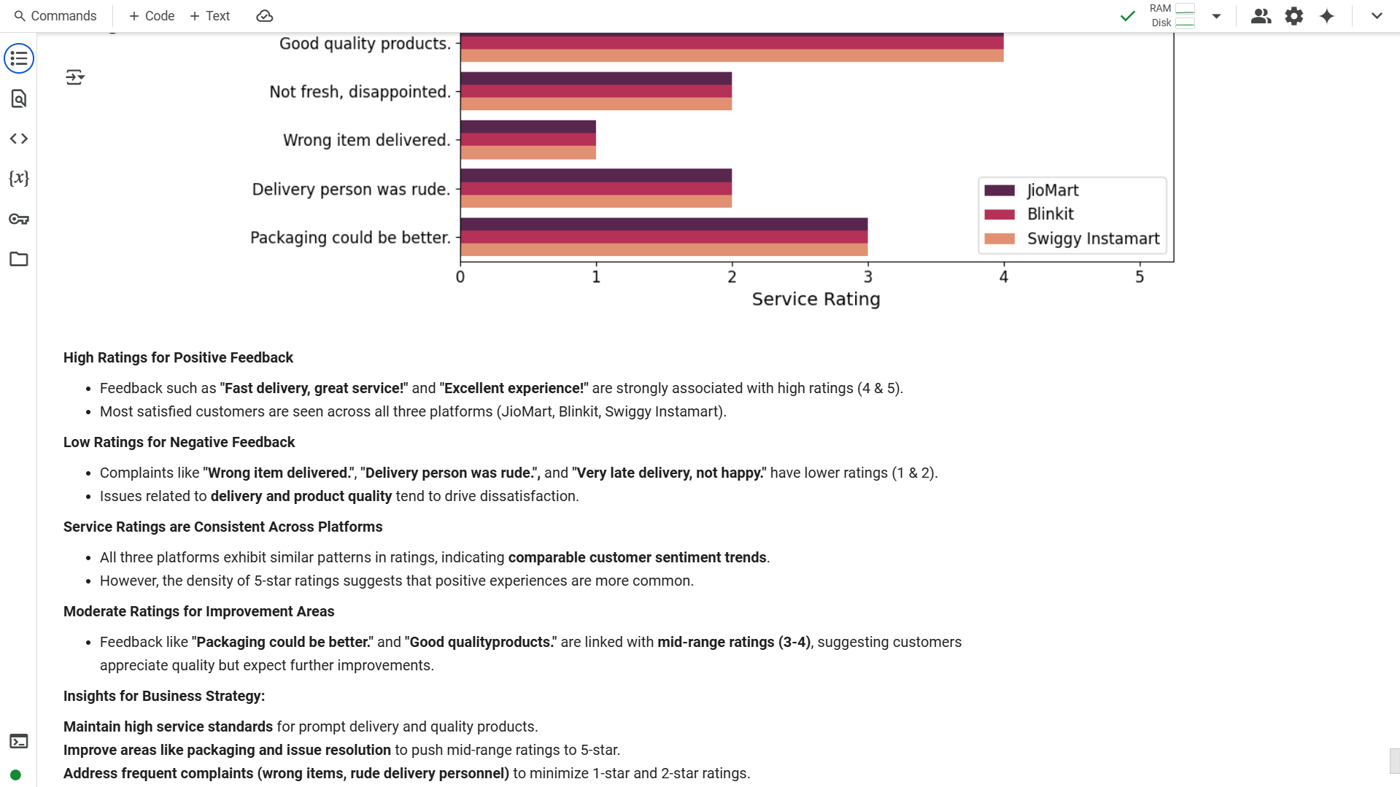

Slide 50
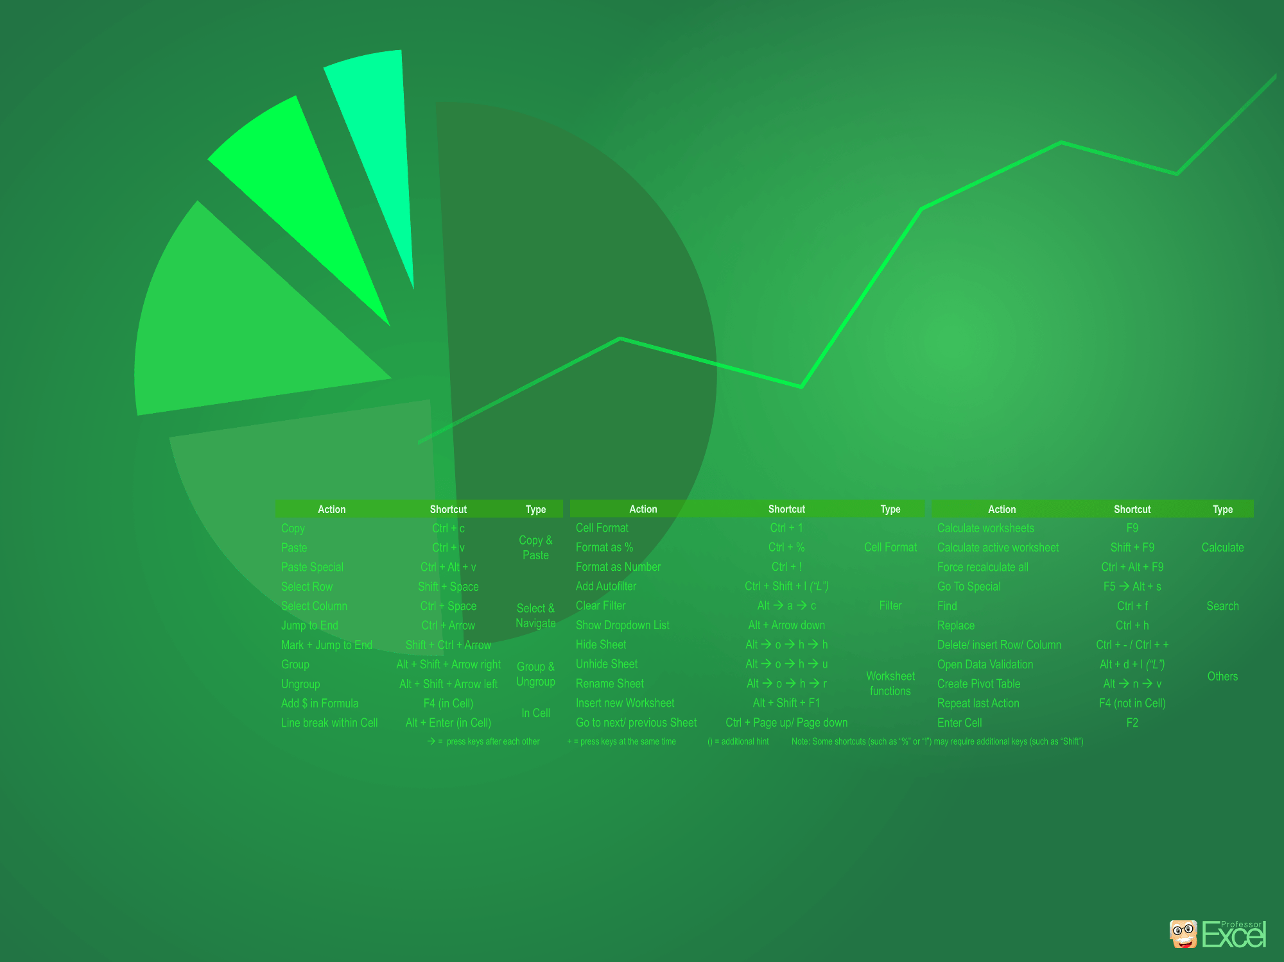
EXCEL
PIVOT TABLE & DASHBOARD

Slide 51
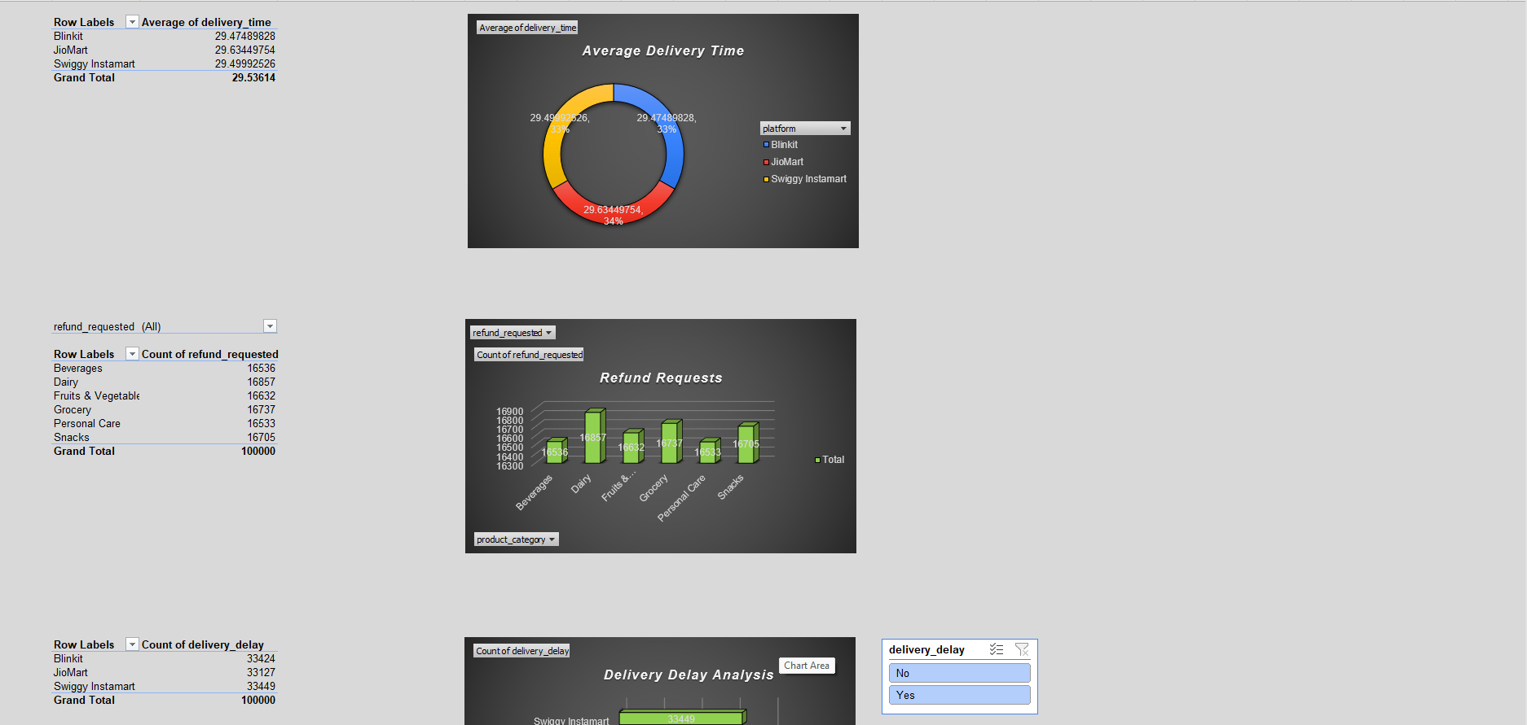

Slide 52
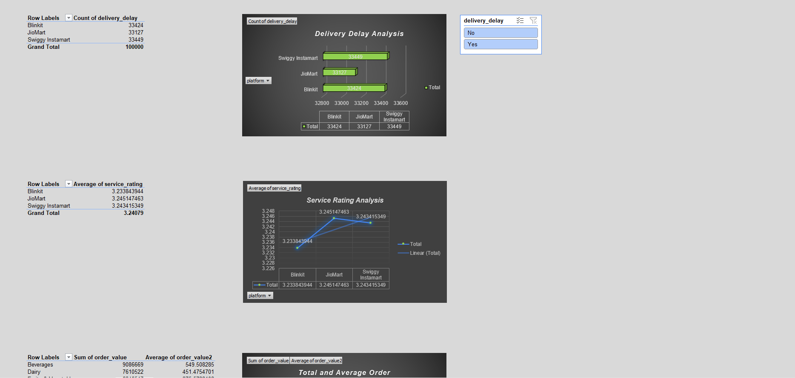

Slide 53
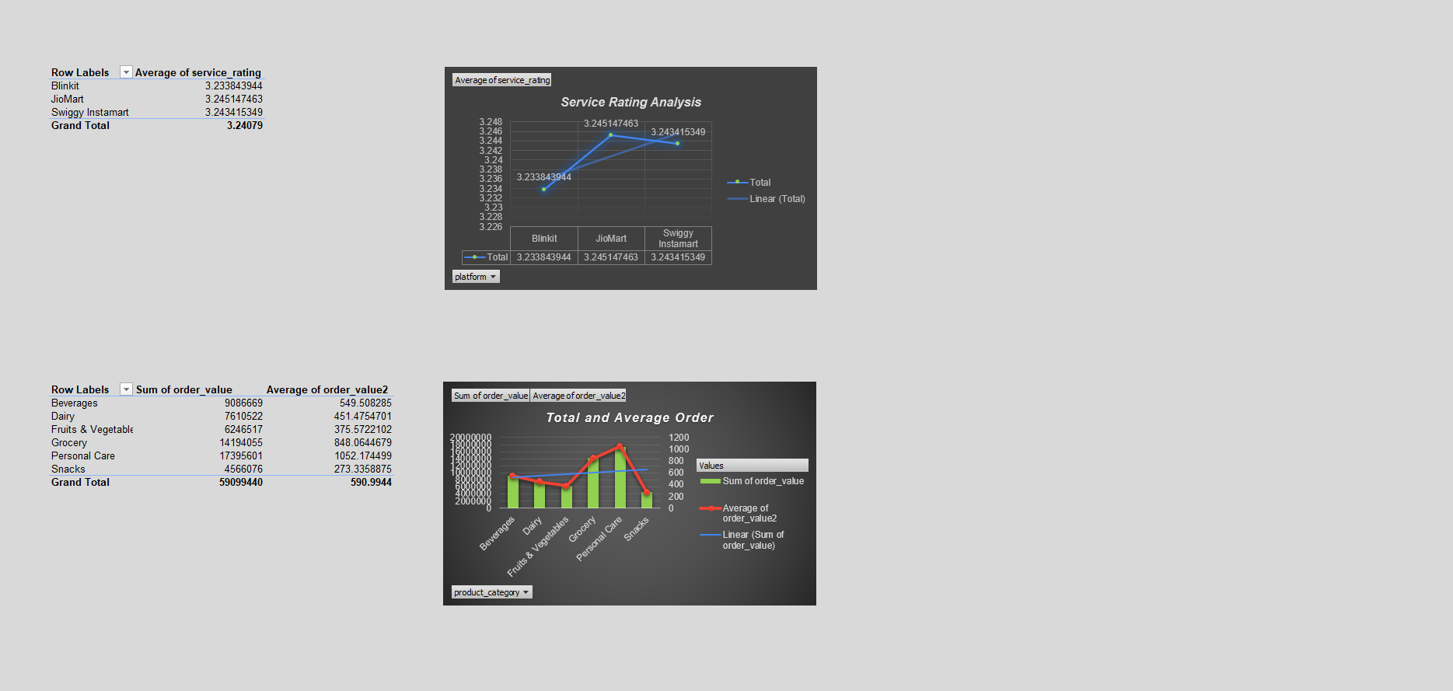

Slide 54
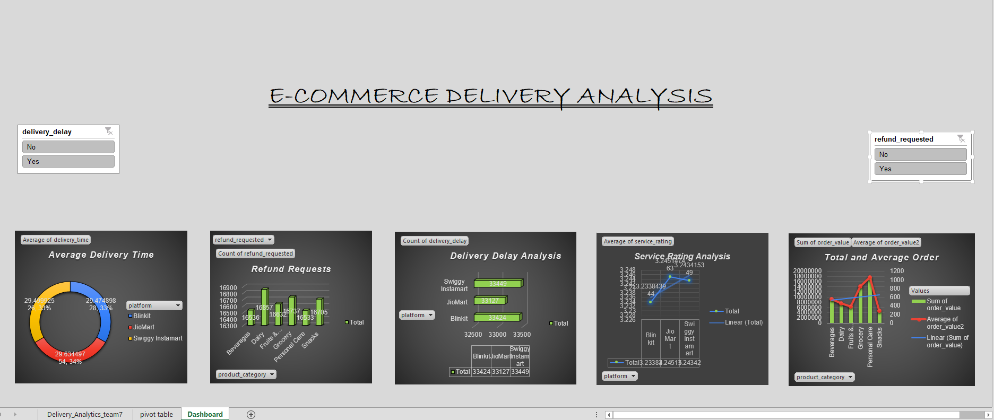

Slide 55

MYSQL
TRIGGERS & CONNECT POWERBI

Slide 56


Slide 57
MySQL code sets up a database for managing e-commerce delivery data across multiple platforms.
Create Database:
A new database named project is created.
Retrieve Data:
The code selects (SELECT * FROM ...) data from three tables:
jiomart
swiggy_instamart
blinkit
Create Tables for Other Platforms:
The tables swiggy_instamart and blinkit are created with the following columns:
order_id (VARCHAR)
customer_id (VARCHAR)
platform (VARCHAR)
ordered_time (VARCHAR)
delivery_time (DOUBLE)
product_category (VARCHAR)
order_value (INT)
customer_feedback (VARCHAR)
service_rating (INT)
delivery_delay (VARCHAR)
refund_requested (VARCHAR)
Create Trigger for Swiggy Instamart:
A trigger named ab is created.
It is executed after a delete operation on jiomart.
When a row is deleted from jiomart, its data is inserted into swiggy_instamart.
Delete Data for Swiggy Instamart from Jiomart:
Rows where platform="Swiggy Instamart" are deleted from jiomart.
Create Trigger for Blinkit:
A trigger named zx is created.
It is executed after a delete operation on jiomart.
When a row is deleted from jiomart, its data is inserted into blinkit.
Delete Data for Blinkit from Jiomart:
Rows where platform="Blinkit" are deleted from jiomart.
Retrieve and Clean Data:
Select data from swiggy_instamart to verify insertion.
Delete rows from swiggy_instamart where platform="Blinkit" to maintain consistency.
Purpose of the Code:
Triggers ensure that deleted records from jiomart are backed up into corresponding platform tables.
Data integrity is maintained by moving records instead of permanent deletion.
It helps in tracking and managing e-commerce delivery operations efficiently across different platforms.

Slide 58

POWERBI
DASHBOARD

Slide 59


Slide 60


Slide 61


